Slide 1


Slide 2

Our
GOAL
Provide information to help people with disabilities and older adults protect themselves during public emergencies.

Slide 3
Let’s Become Our Own First Responders . . . Together

Slide 4
www.BeReadyNV.org
Earthquakes | Rain/Flooding
Heatwaves | Blizzards
Fires
Terrorism | Shootings
Pandemics

Slide 5

Notes:
Lisa talks about the actual website

Slide 6
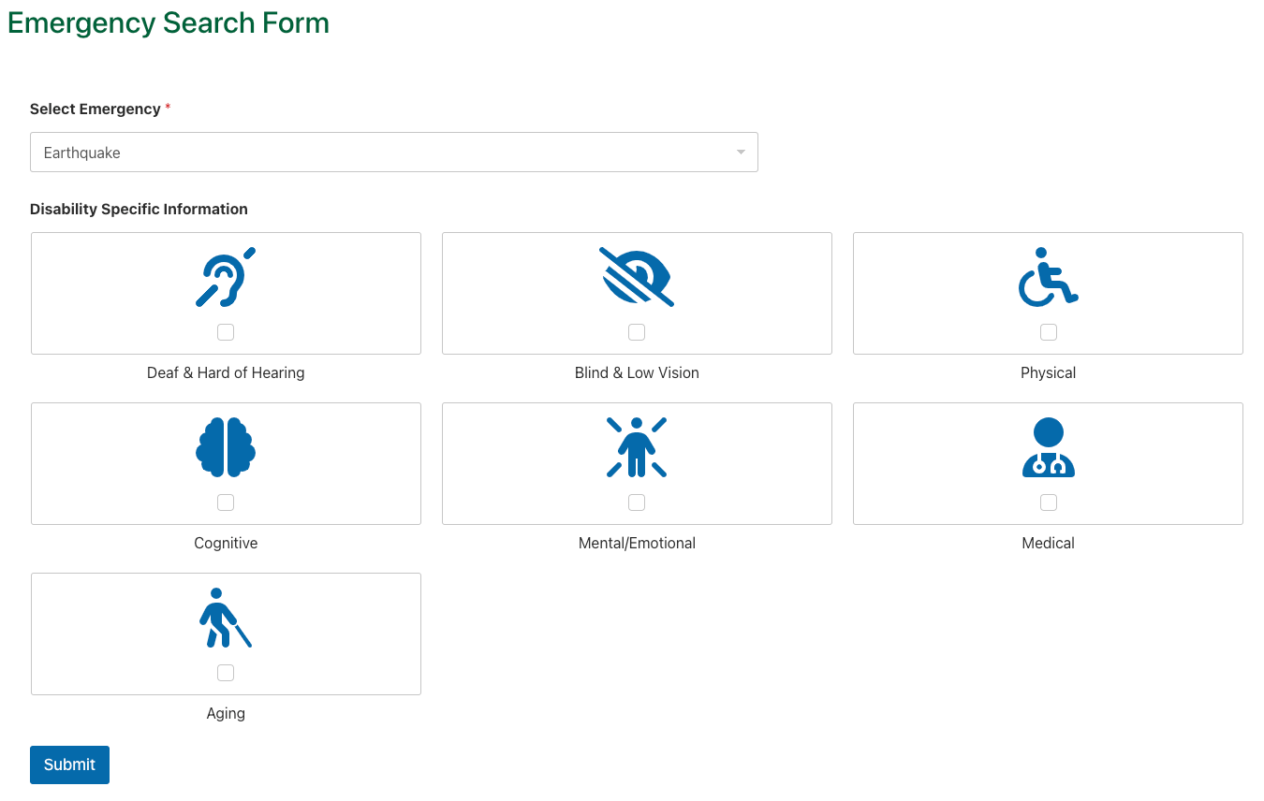

Slide 7

CENTERS FOR
INDEPENDENT LIVING
WHAT’S
YOUR
PLAN?

Slide 8
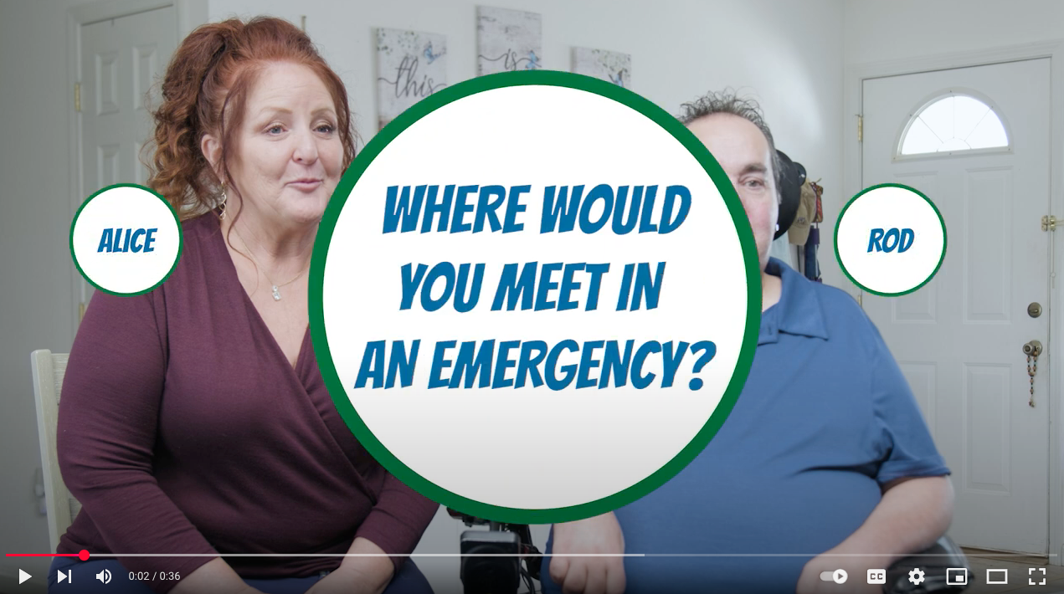

Slide 9
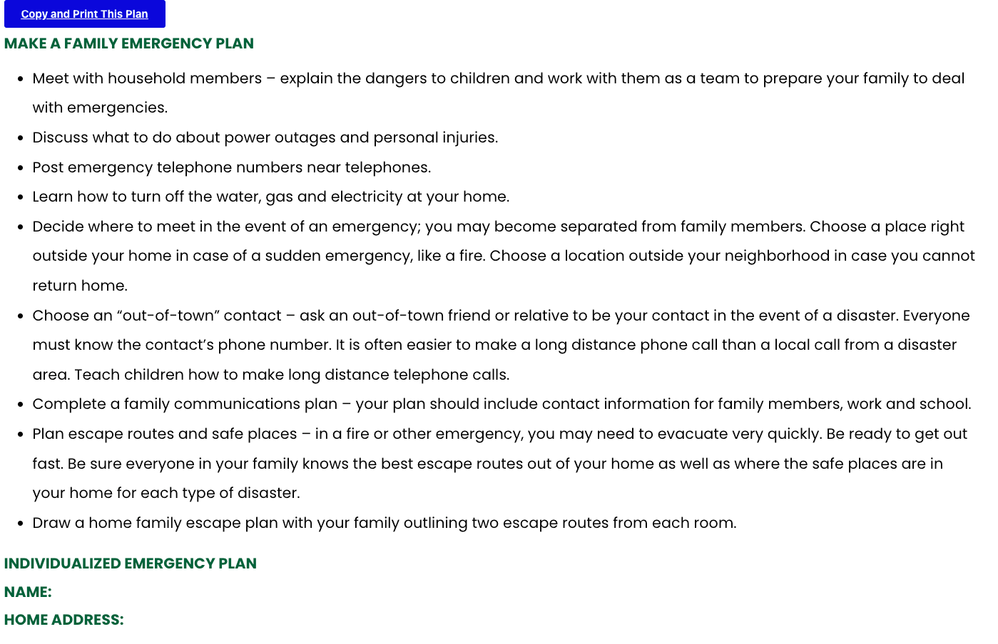

Slide 10
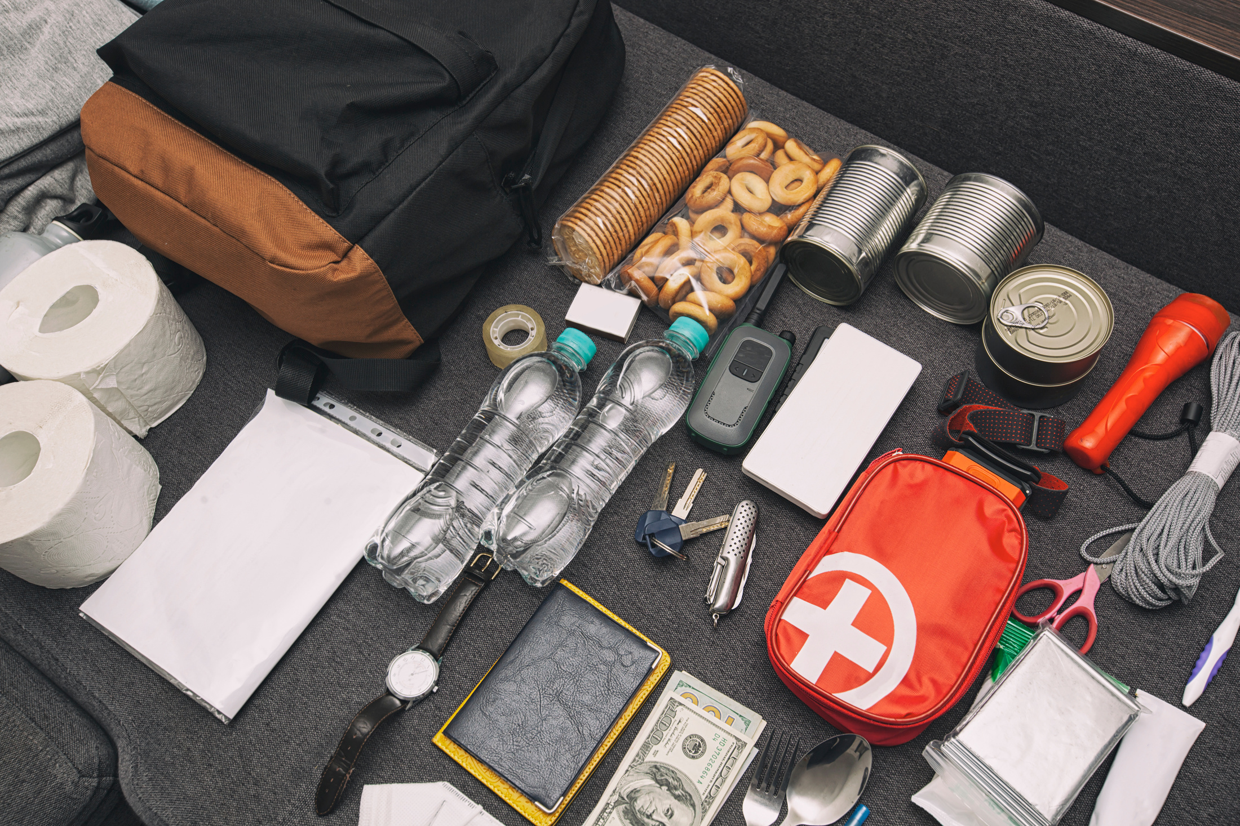
PLAN FOR YOUR SPECIFIC NEEDS
CENTERS FOR
INDEPENDENT LIVING
WHAT’S IN
YOUR
BAG?

Slide 11
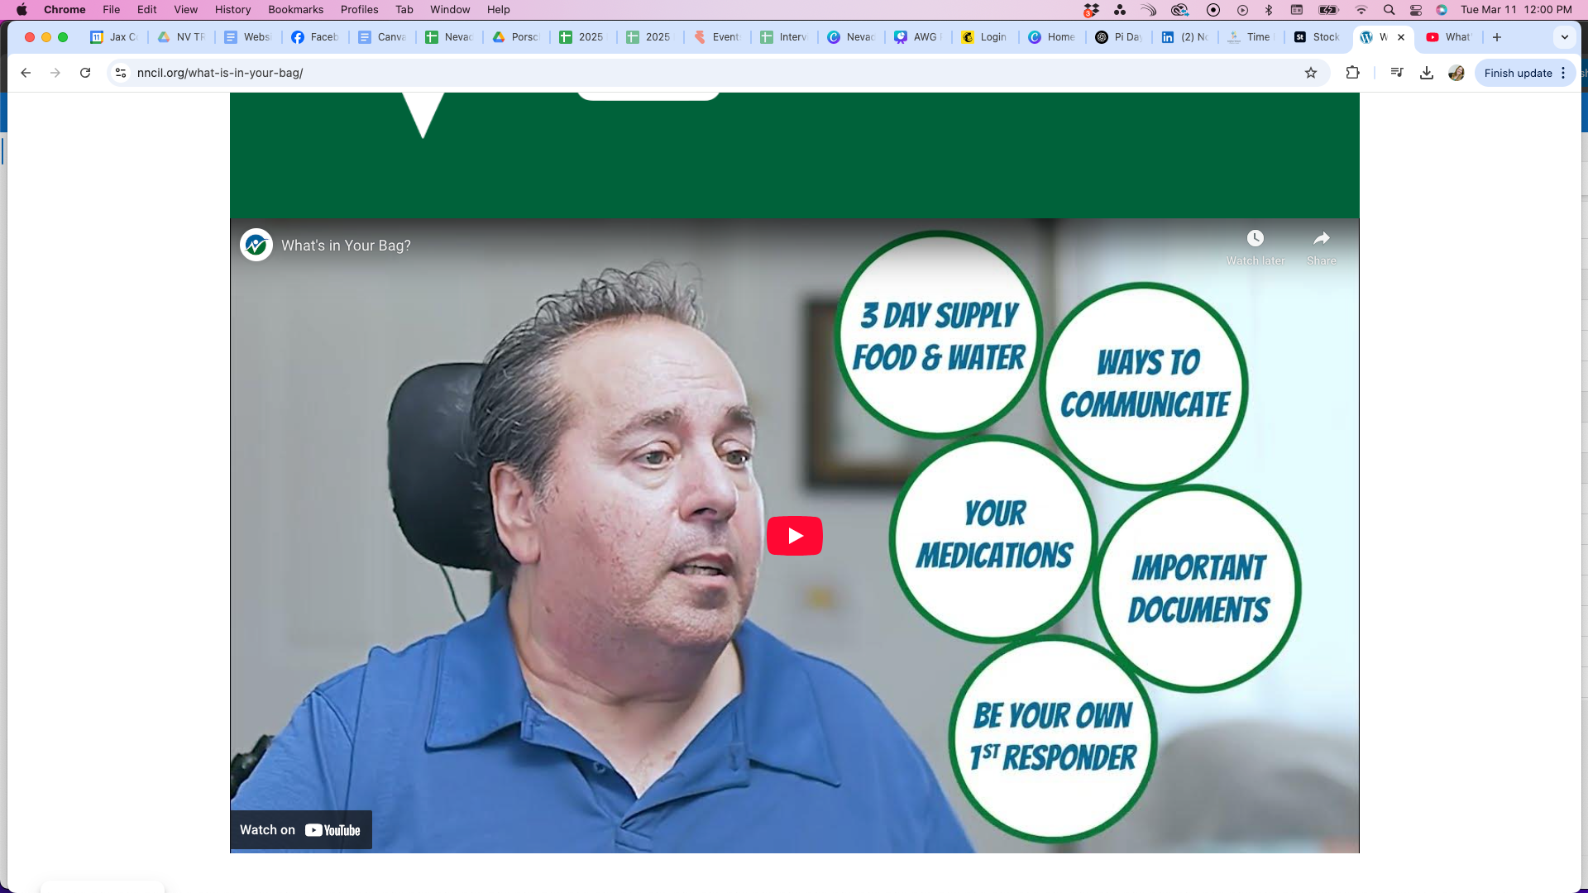

Slide 12
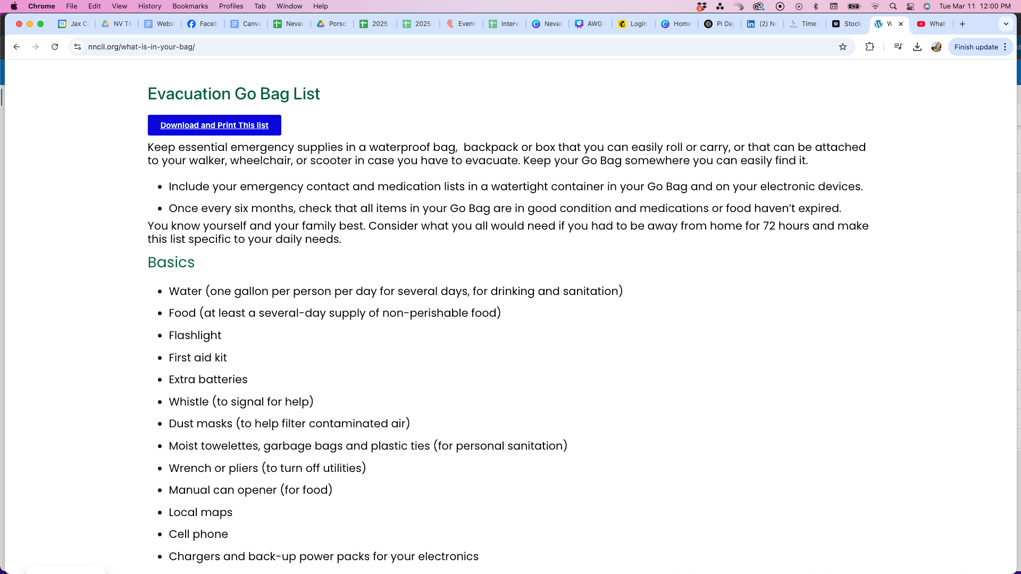

Slide 13
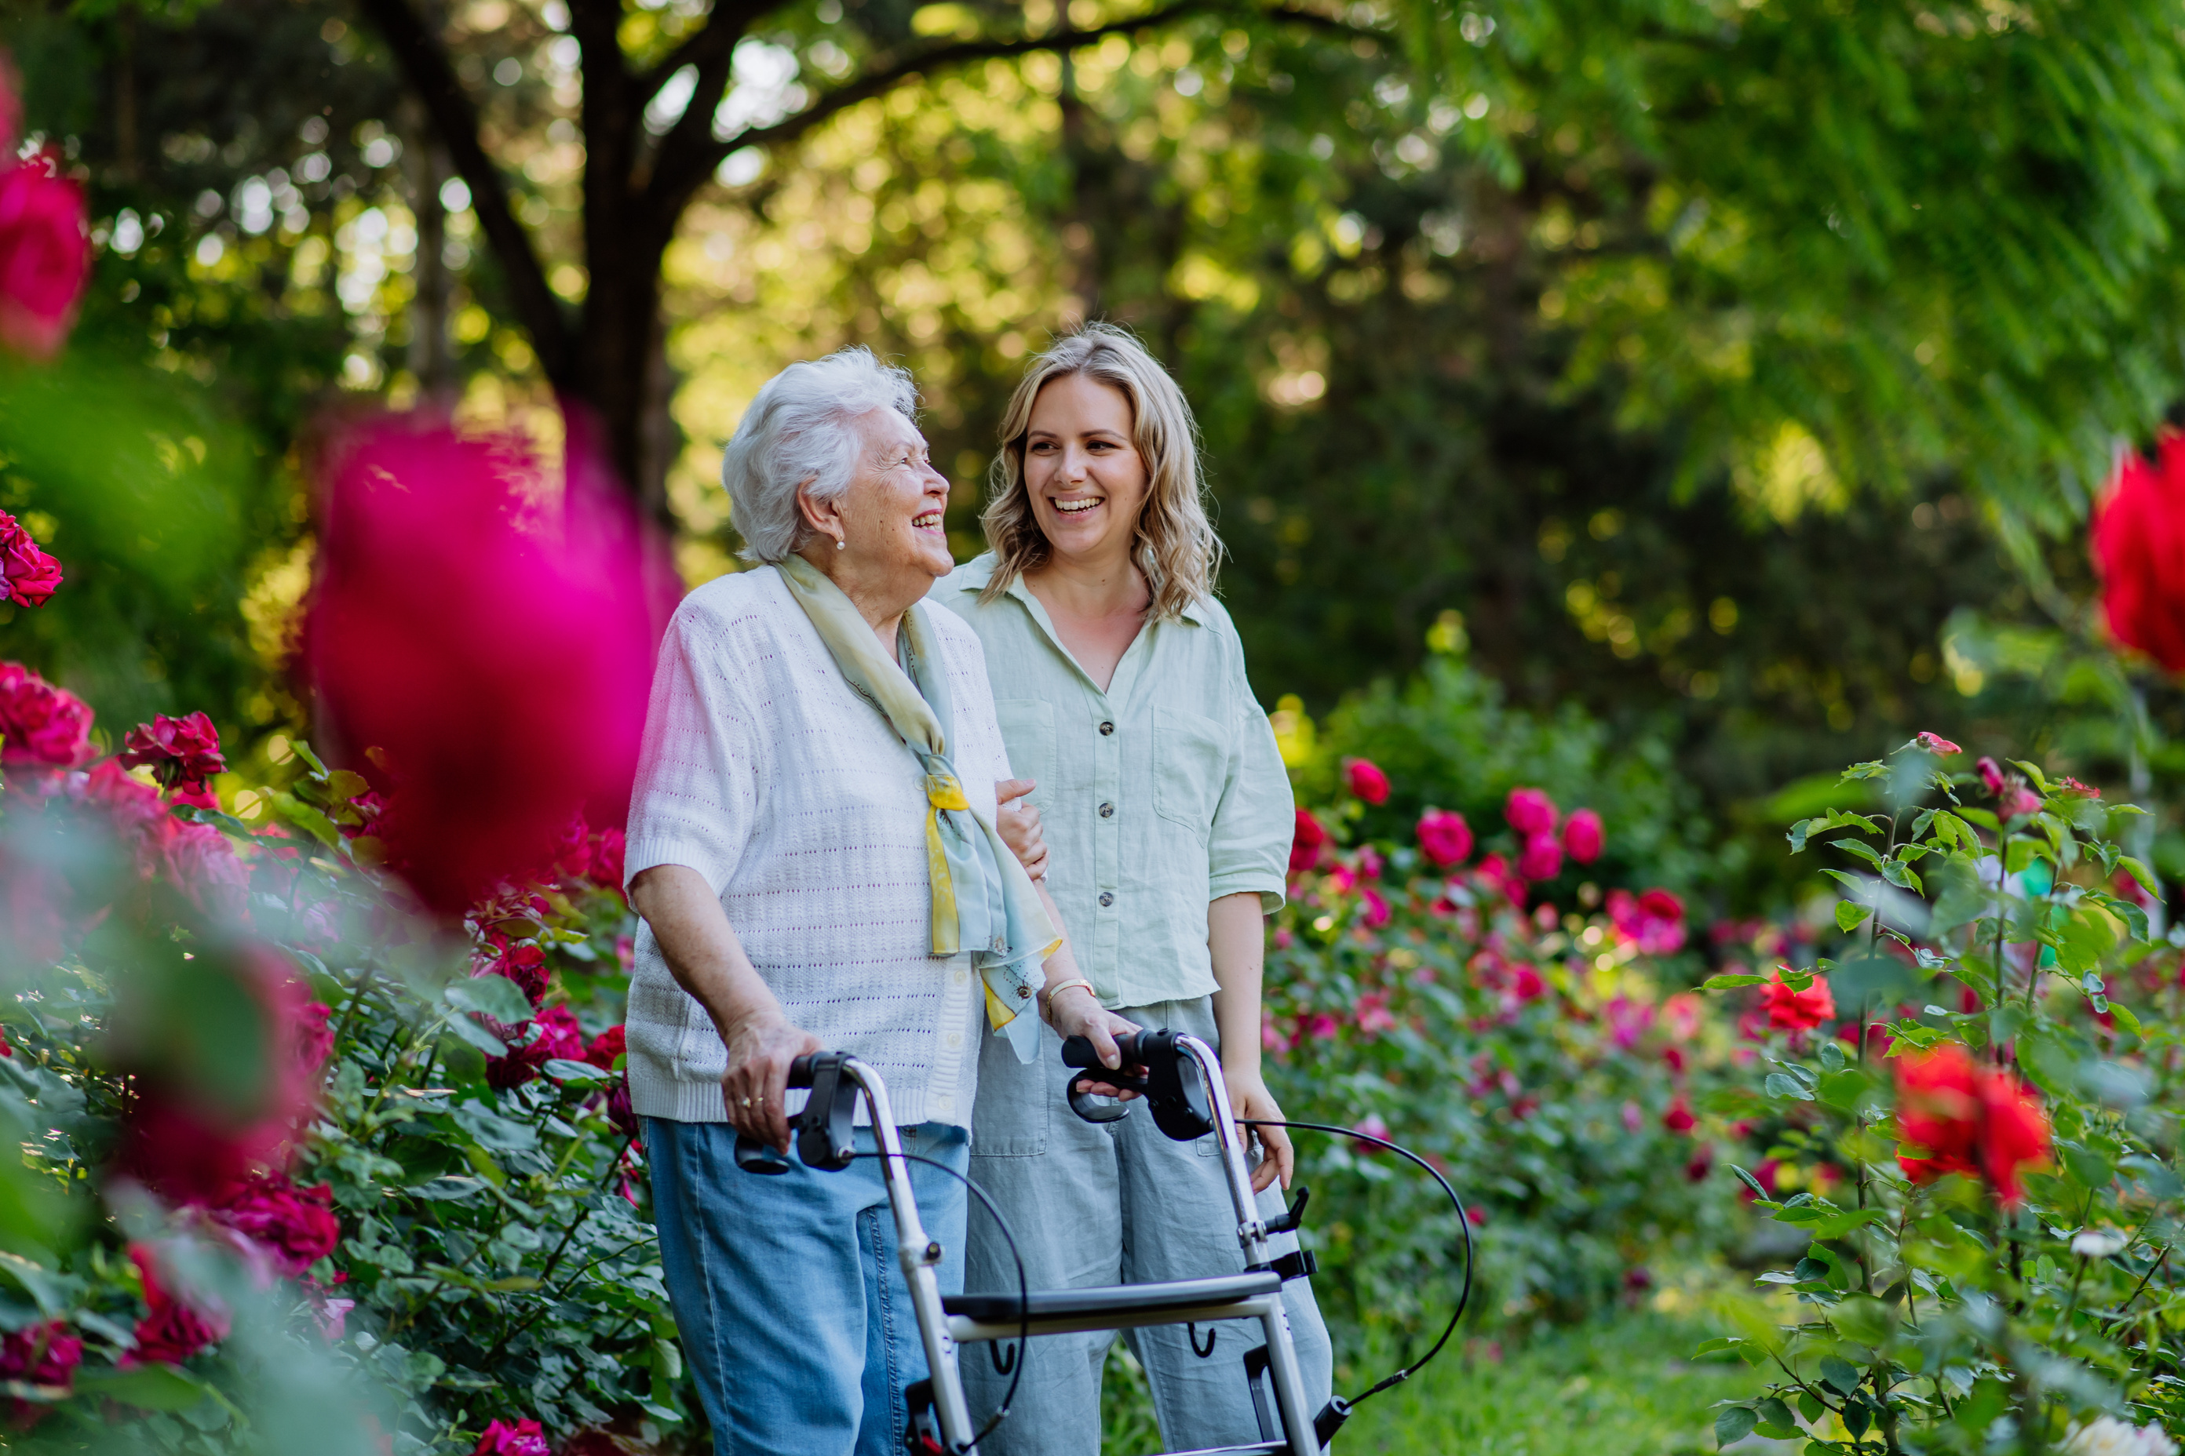
CENTERS FOR
INDEPENDENT LIVING
WHO ARE
YOUR
PEOPLE?

Slide 14
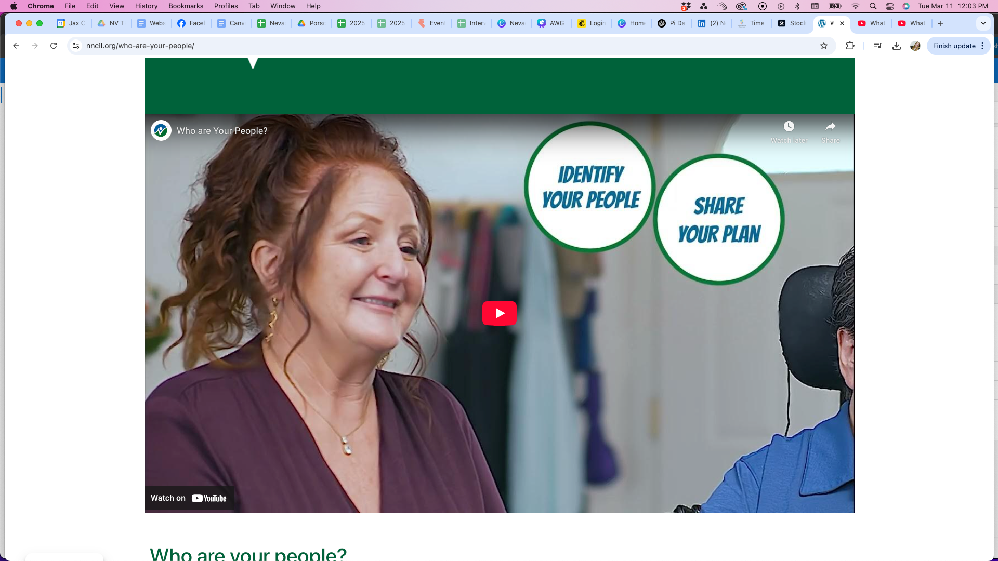

Slide 15
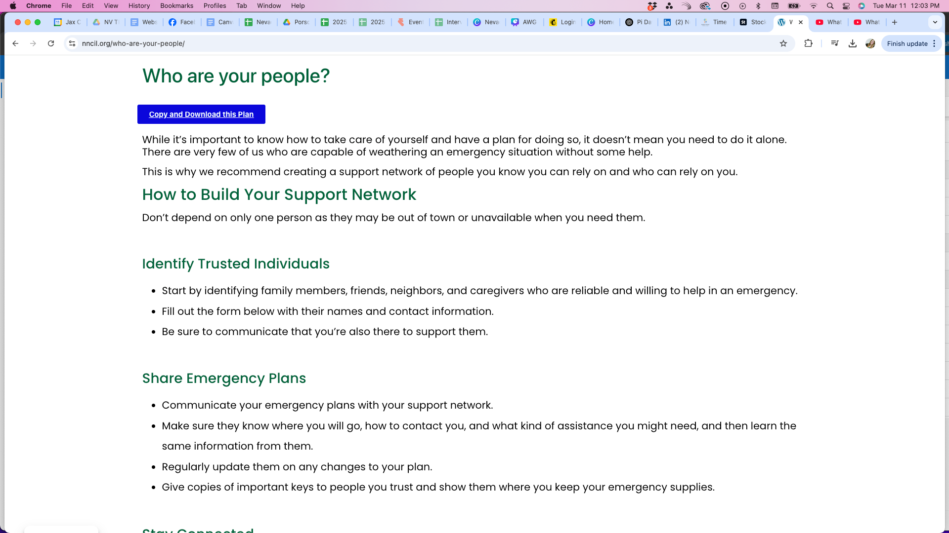

Slide 16
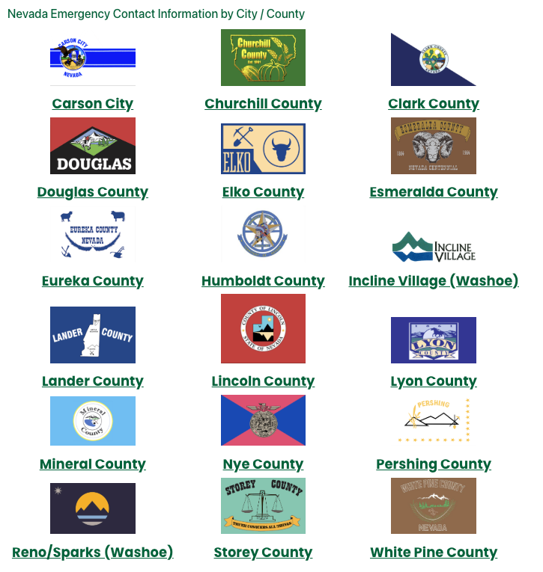
WHERE
DO YOU
LIVE?

Slide 17

INTERACTIVE
WORKSHOPS
  Partner Agencies
  Throughout the state

Slide 18

QUESTIONS?

Slide 19



Please share
YOUR THOUGHTS
INFO@NNCIL.ORG
SNCIL@SNCIL.ORG
Southern Nevada
Center for Independent Living

Slide 20
Emergency Preparedness Information
Grant funded by the American Rescue Plan Act and the Administration for Community Living

