Slide 1
Division of Public and Behavioral Health
FY 2024-25 Budget Summary
Cody Phinney, Administrator
July 6, 2023

Slide 2
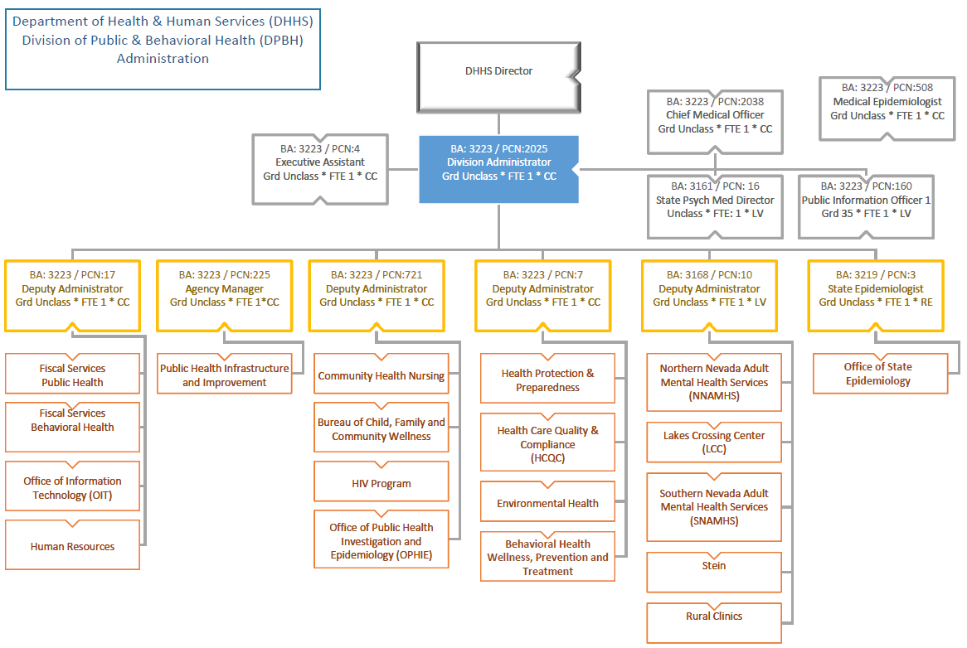
Division of Public and Behavioral Health Organizational Chart
Charts and tables created by the Department of Health and Human Services, Division of Public and Behavioral Health

Slide 3
Summary of Agency Sections
Community Health Services
Regulatory and Planning Services
Clinical Services
Behavioral Health Policy
Administrative Services
Office of State Epidemiology
Public Health Infrastructure and Improvement
Community Health Services: provides core public health prevention programs and services by establishing and maintaining relationships with community partners, identifying and maximizing resources, and collaborating to improve public health outcomes for all communities within Nevada.
Office of State Epidemiology: provides a comprehensive epidemiology structure that focuses on infectious disease, environmental, occupational, chronic disease, health equity, and facility-based epidemiology. This section is responsible for statewide standards and systematic data collection across the state. This section also supports preparation, prevention of outbreaks and poor health outcomes, and surveillance efforts which can help inform upstream policies and decisions across DHHS.
Regulatory and Planning Services: provides licensing and certification of healthcare facilities, childcare facilities, medical laboratories and personnel, dietitians, music therapists and food establishments. This section is also responsible for vital records (birth/death and marriage/divorce records), medical marijuana regulation, emergency medical systems, public health preparedness and radiation control.
Clinical Services: provides direct services for those suffering from mental illness by operating inpatient hospitals at both ends of the state. The civil hospitals include Rawson-Neal, in Las Vegas, and Dini-Townsend, in Sparks. The forensic hospitals include Lakes Crossing Center and Stein Muri Forensic Hospital. Additionally, outpatient services are provided statewide, including the rural and frontier communities for public and mental health needs.
Behavioral Health Policy: provides oversight and quality assurance to behavioral health providers statewide; designs, plans, funds, and implements systems of care, including behavioral health prevention, early intervention, treatment and recovery support services; establishes funding priorities for behavioral health services and supports through close collaboration with communities and stakeholders; evaluates outcomes of behavioral health interventions; and guides policy and financing options across DHHS.
Administrative Services: provides leadership, support for fiscal services, human resources and information and technology.
Public Health Infrastructure and Improvement: provides oversight of statewide improvement in public health infrastructure and improvement. This includes workforce initiatives, public health accreditation, data modernization, and public information.

Slide 4
Division of Public and Behavioral Health Behavioral Health Budget Accounts Only Budgeted Funding Sources 2022-23 and 2024-25 Biennium
$1,015,540,352
$1,143,581,919
Charts and tables created by the Department of Health and Human Services, Division of Public and Behavioral Health

Slide 5
Summary by Budget Account
Legislatively Approved Budget (L01) |  | Fiscal Year 2024 |  |  |  | Fiscal Year 2025
406 | DPBH: BH BA Only | General Fund | Federal Funds | Other | Total | General Fund | Federal Funds | Other | Total
3161 | SNAMHS | $98,388,510 | $1,030,296 | $30,915,480 | $130,334,286 | $101,772,500 | $1,028,263 | $40,079,669 | $142,880,432
3162 | NNAMHS | $24,933,627 | $504,657 | $1,895,089 | $27,333,373 | $25,636,366 | $504,657 | $1,896,580 | $28,037,603
3165 | Crisis Response | $0 | $110,719 | $45,316,581 | $45,427,300 | $0 | $0 | $24,924,918 | $24,924,918
3168 | DPBH Health Administration | $0 | $0 | $5,494,353 | $5,494,353 | $0 | $0 | $4,895,237 | $4,895,237
3170 | Behavioral Health Prev & Treatment | $6,051,842 | $55,152,929 | $3,734,699 | $64,939,470 | $6,151,451 | $54,968,225 | $853,399 | $61,973,075
3200 | Prev/Treat of Problem Gambling | $2,082,192 | $0 | $0 | $2,082,192 | $2,105,591 | $0 | $0 | $2,105,591
3255 | Alcohol Tax Program | $0 | $0 | $2,336,874 | $2,336,874 | $0 | $0 | $2,844,673 | $2,844,673
3645 | Lake's Crossing | $14,208,709 | $0 | $1,251,195 | $15,459,904 | $14,607,098 | $0 | $1,071,954 | $15,679,052
3648 | Rural Clinics | $14,638,775 | $370,467 | $3,418,106 | $18,427,348 | $14,923,160 | $370,467 | $3,303,631 | $18,597,258
 | DPBH Total: | $160,303,655 | $57,169,068 | $94,362,377 | $311,835,100 | $165,196,166 | $56,871,612 | $79,870,061 | $301,937,839
 |  |  |  |  | Biennial Total | $325,499,821 | $114,040,680 | $174,232,438 | $613,772,939
Charts and tables created by the Department of Health and Human Services, Division of Public and Behavioral Health

Slide 6
BA 3161 Southern Nevada Adult Mental Health Services
Overview
Civil: Behavioral Health Services, in Clark County, provide inpatient and outpatient treatment for individuals with mental illness.
Forensic: Treatment and evaluation services to mentally disordered criminal offenders for whom there is a doubt regarding their competency to proceed with adjudication.
Overview:
With minor deviations for employees with a collective bargaining agreement, all employees generally received a 12% compensation increase in SFY24 and 23% (12% + 11%) increase in SFY25 (note PERS contribution increases 7% in SFY25 for a net increase of 12% + 4% = 16%).
Correctional Lieutenants positions statewide received an additional one-grade (5%) compensation increase
Correctional Sergeant, Senior Correctional Officer, Correctional Officer, Correctional Officer Trainee and Forensic Specialist positions statewide received an additional two-step (10%) compensation increase.

Slide 7
BA 3161 Southern Nevada Adult Mental Health Services
Budget Information/Changes
Budget funded through General Fund, federal funds and other funds (such as inter-agency transfers, Medicaid, Medicare and private insurance).
Enhancements
M201 – Requests one additional contract Psychiatrist for medication clinic services caseload.
SFY24 Total Cost – $254,266 State General Fund – $254,266
SFY25 Total Cost – $344,171 State General Fund – $344,171
E380 – Requests transitioning 12 Intermittent Temporary Forensic Specialists positions to permanent FTEs along with operating costs to maintain 13 additional forensic beds.
SFY24 Total Cost – $1,194,596 State General Fund – $1,194,596
SFY25 Total Cost – $1,236,283 State General Fund – $1,236,283

Slide 8
BA 3161 Southern Nevada Adult Mental Health Services
Enhancements (continued)
E381 – Requests 21 Forensic Specialist FTEs for the Rawson Neal D-Pod to provide 24-hour direct care services to court ordered forensic clients.
SFY24 Total Cost – $1,681,145 State General Fund – $1,681,145
SFY25 Total Cost – $2,296,874 State General Fund – $2,296,874
E382 – Requests 16 new Psychiatric Nurse positions for the Rawson Neal D-Pod to provide 24-hour patient care for forensic clients.
SFY24 Total Cost – $1,570,921 State General Fund – $1,570,921
SFY25 Total Cost – $2,075,349 State General Fund – $2,075,349

Slide 9
BA 3161 Southern Nevada Adult Mental Health Services
Enhancements (continued)
E383 – Requests one Forensic Psychologist FTE and one contract Forensic Psychiatrist for Stein forensic services.
SFY24 Total Cost – $394,196 State General Fund – $394,196
SFY25 Total Cost – $532,036 State General Fund – $532,036
E673 – Requests a two-grade increase for Correctional Sergeant, Forensic Specialist 3 and Forensic Specialist 4 FTEs.
SFY24 Total Cost – $663,756 State General Fund – $663,756
SFY25 Total Cost – $687,055 State General Fund – $687,055
E674 – Requests a one-grade increase for Correctional Lieutenant.
SFY24 Total Cost – $4,406 State General Fund – $4,406
SFY25 Total Cost – $4,461 State General Fund – $4,661

Slide 10
BA 3162 Northern Nevada Adult Mental Health Services
Overview
Civil: Behavioral health services, in Washoe County, provide inpatient and outpatient treatment for individuals with mental illness.

Slide 11
BA 3162 Northern Nevada Adult Mental Health Services
Budget Information/Changes
Budget funded through General Fund, federal funds and other funds (such as inter-agency transfers, Medicaid, Medicare and private insurance).
Enhancements
M202 – This request eliminates three Psychiatric Caseworker positions and associated costs based on caseload adjustments.
SFY24 Total Cost – ($217,455) State General Fund – ($217,455)
SFY25 Total Cost – ($228,638) State General Fund – ($228,638)

Slide 12
BA 3165 Crisis Response
Overview
The mission of the Crisis Response System is to stand up a comprehensive Suicide Lifeline Program, as defined in NRS 433.702 through 433.710. This includes establishing and maintaining standards for crisis stabilization centers and a network of such centers, certifying and funding designated mobile crisis teams, collecting, managing, and obligating the revenue generated from the fee imposed on telecommunications providers, and ensuring the Suicide Lifeline meets and maintains standards.

Slide 13
BA 3165 Crisis Response
Budget Information/Changes
Budget funded through fees.
Enhancements
E225 – This request adds ten FTEs (one Health Program Manager position, three Health Program Specialist positions, two Management Analyst positions, one Public Information Officer position, one Quality Assurance Specialist position, one Accounting Assistant position, one Administrative Assistant position) and associated operating costs to support emergency crisis response activities.
SFY24 Total Cost – $686,239 State General Fund – $0
SFY25 Total Cost – $757,397 State General Fund – $0
E226 – This request transfers funding to the DHHS DO Data Analytics Office to support one new Biostatistician positions.
SFY24 Total Cost – $85,429 State General Fund – $0
SFY25 Total Cost – $113,285 State General Fund – $0
E227 – Requests to fund one existing Clinical Program Planner II FTE and fund emergency crisis response activities with crisis response telecommunications fees.
SFY24 Total Cost – $14,275,150 State General Fund – $0
SFY25 Total Cost – $13,958,015 State General Fund – $0

Slide 14
BA 3168 Behavioral Health Administration
Overview
Working in partnership with consumers, families, advocacy groups, agencies, and diverse communities, the Behavioral Health Administration Office provides responsive services and informed leadership to ensure quality outcomes.

Slide 15
BA 3168 Behavioral Health Administration
Budget Information/Changes
Budget is funded through cost allocation and other funds (such as inter-agency transfers and Medicaid Admin).
Enhancements/transfers
E226 – Requests one Administrative Services Officer IV FTE to provide fiscal oversight and management of Behavioral Health budget accounts.
SFY24 Total Cost – $163,185 State General Fund – $0
SFY25 Total Cost – $155,847 State General Fund – $0

Slide 16
BA 3170 Behavioral Health Wellness, Prevention and Treatment
Overview
The mission of the Bureau of Behavioral Health Wellness, Prevention and Treatment is to reduce the impact of substance abuse and mental illness in Nevada. This is accomplished by identifying and responding to the alcohol and drug concerns of Nevadans, facilitating a continuum of care through high quality education, prevention, and treatment services by providing oversight and funding for community-based, public and private nonprofit organizations.

Slide 17
BA 3645 Lakes Crossing Center
Overview
Lakes Crossing Center (LCC) provides treatment and restoration services to mentally disordered criminal offenders for whom there is a doubt regarding their competency to proceed with adjudication. These services are provided on an inpatient basis. The facility also treats clients determined Not Guilty by Reason of Insanity and un-restorable clients who are too dangerous to commit to a civil psychiatric hospital.

Slide 18
BA 3645 Lakes Crossing Center
Budget Information/Changes
Budget funded through General Fund and other funds including Social Security Administration and forensic certification training fees.
Enhancements
E673 – Requests a two-grade increase for Senior Correctional Officer, Forensic Specialist III and Forensic Specialist IV FTEs.
SFY24 Total Cost – $453,957 State General Fund – $453,957
SFY25 Total Cost – $465,532 State General Fund – $465,532
E674 – Requests a two-grade increase for Correctional Lieutenant FTEs.
SFY24 Total Cost – $5,538 State General Fund – $5,538
SFY25 Total Cost – $5,581 State General Fund – $5,581

Slide 19
BA 3648 Rural Clinics
Overview
Rural Clinics provides a full array of outpatient behavioral and/or mental health services, including collaborating with community partners to ensure timely access to services for people of all ages who are living in Nevada’s twelve rural and frontier counties.

Slide 20
BA 3648 Rural Clinics
Budget Information/Changes
Budget funded through General Fund, federal funds and other funds (such as inter-agency transfers, Medicaid, Medicare and private insurance).
Enhancements
E228 – Requests additional office space at the rural clinics in Fernley, Yerington, and Panaca.
SFY24 Total Cost – $89,794 State General Fund – $89,794
SFY25 Total Cost – $36,807 State General Fund – $36,807
E350 – Requests additional funds for Mental Health Court rental assistance.
SFY24 Total Cost – $48,000 State General Fund – $48,000
SFY25 Total Cost – $48,000 State General Fund – $48,000

Slide 21
Appropriations Act - Back Language
Authorized to transfer the sums appropriated to DPBH for the Lakes Crossing Center, Northern Nevada Adult Mental Health Services and Southern Nevada Adult Mental Health Services budget accounts between those budget accounts with the approval of the Interim Finance Committee upon the recommendation of the Governor.
Authorized the sums appropriated to the DPBH for deferred maintenance and extraordinary maintenance projects approved within agency budgets to be available for both fiscal years and transferred within the same budget account from one fiscal year to the other with the approval of the Interim Finance Committee upon the recommendation of the Governor.

Slide 22
Questions?

Slide 23
Contact Information
Cody Phinney
Julie Lindesmith
Administrator
Agency Manager
c.phinney@health.nv.gov
jlindesmith@health.nv.gov
http://dpbh.nv.gov/

Slide 24
Acronyms
BA- Budget Account
BH- Behavioral Health
BHP&T- Behavioral Health, Prevention and Treatment
CC- Carson City
DHHS- Department of Health and Human Services
DO- Director’s Office
DPBH- Division of Public and Behavioral Health
FTE- Full Time Equivalency
FY- Fiscal Year
LCC- Lakes Crossing Center
LV- Las Vegas
NNAMHS- Northern Nevada Adult Mental Health Services
NRS- Nevada Revised Statutes
PCN- Position Control Number
RE- Reno
SNAMHS- Southern Nevada Adult Mental Health Services

