Slide 1

Cover Slide for Rural Regional Behavioral Health Policy Board Bill Presentation
Title slide
Rural Regional Behavioral health policy Board
Valerie Haskin, MA, MPH
Rural Regional Behavioral Health Coordinator
AB 37 Summary Presentation to the Nevada Behavioral Health Planning and Advisory Council
January 11, 2023

Slide 2
Rural RBHPB Concept for AB37 82nd (2023) Legislative Session
Build out a robust pipeline for behavioral health providers in Nevada
Based on successful models from Nebraska and Illinois
Would incorporate and expand upon existing successful programs, and introduce new programs and connections across the educational system and professional licensing
AB 37 “Authorizes the establishment of the Behavioral Health Workforce Development Center of Nevada”
K-12 Education
NSHE and other Higher Ed. Institutions
Professional Licensing
Professional Practice

Slide 3
Summary of AB 37
Collaborate with School Districts to support and expand Career and Technical Education (CTE) Programming related to behavioral health professions in schools
Collaborate with Area Health Education Centers (AHECs) to include focus on behavioral health professions
Bolster efforts to support minority and disadvantaged youth in considering careers in behavioral health
Look for ways to weave SEL and Mental Health support programs with students as leaders or peer supports to increase interest
K-12 Education
NSHE and other Higher Ed. Institutions
Professional Licensing
Professional Practice

Slide 4
Summary of AB 37
Professional programs at NSHE focused upon:
Marriage and Family Therapy, Clinical Professional Counseling, Psychology, Psychiatry, Clinical Social Work, Behavior Analysts, all Drug and Alcohol Counselor types, and specialty medical tracks (psychiatric Nurse Practitioners, PAs, etc.)
K-12 Education
NSHE and other Higher Ed. Institutions
Professional Licensing
Professional Practice

Slide 5
Summary of AB 37
Ensure undergraduate students are prepared for rigors of graduate school
Ensure clear pathways for undergraduate education to graduate school are created (courses needed, application and test deadlines, testing preparation, etc.)
Create easily-accessible opportunities for high-quality graduate and clinical internships/practicum, with an emphasis on creating opportunities to work with communities with least access to appropriate care (Rural, BIPOC, LGTBQ+, etc.) to ensure competent workforce with these experiences
K-12 Education
NSHE and other Higher Ed. Institutions
Professional Licensing
Professional Practice

Slide 6
Summary of AB 37
Expand the number of approved internship sites and supervisors through targeted training and approval efforts.
Work with licensing boards (not already doing so) to create processes to improve efficiency related to licensing for Nevadans, and those coming from out of state
K-12 Education
NSHE and other Higher Ed. Institutions
Professional Licensing
Professional Practice

Slide 7
Summary of AB 37
Work with Nevada Health Corps and federal programs to help place providers in rural and underserved communities for longer-term practice for tuition assistance/forgiveness (existing programs)
Identify opportunities to educate new providers on the “business” of practice in Nevada, including setting up insurance reimbursement, liability insurance, business licensing, etc.
Recruit eligible providers as approved supervisors and/or sites for undergraduate, graduate, and clinical internships.
K-12 Education
NSHE and other Higher Ed. Institutions
Professional Licensing
Professional Practice

Slide 8

Intention for Infrastructure
Not a brick-and-mortar “center”
Fiscal note should be focused on programming and staffing, not on new buildings
Remote work may promote collaboration across all NSHE institutions providing education for future behavioral health providers
Allows for participation of staff representing multiple communities and may ease recruitment

Slide 9
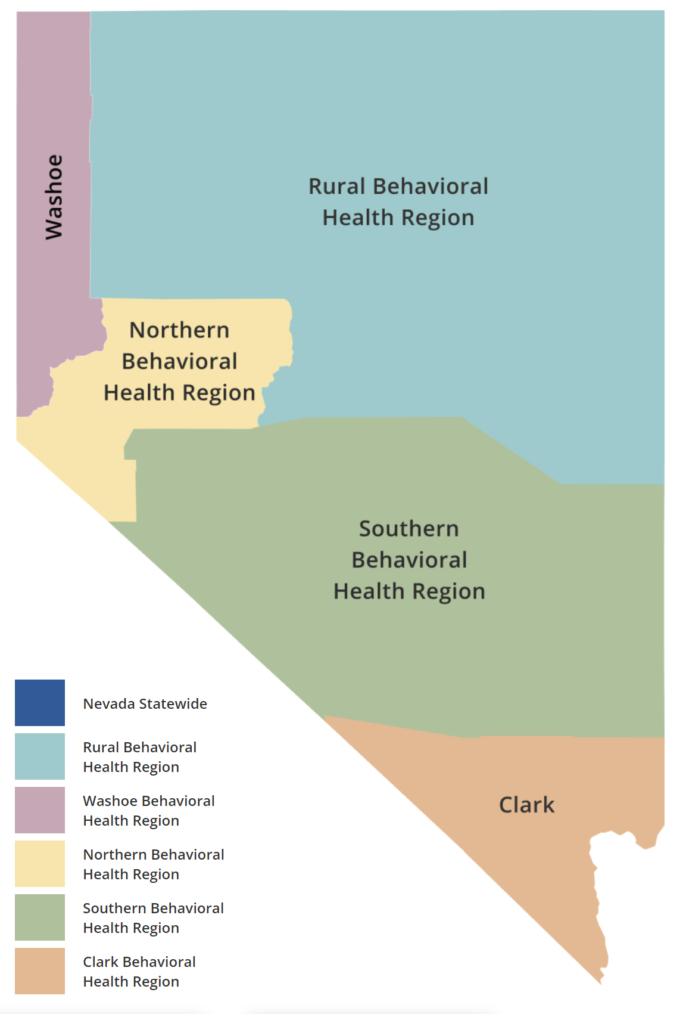

“Hub-and-Spoke” Model for Infrastructure
Main “Hub” within University of Nevada Institutions
Spokes to regional “hubs” in each Behavioral Health Region where the Center is not otherwise represented
Regional hubs will have specialty training or experiences to enrich both clinical training programs and to support local recruitment efforts
hub
UNR &/or UNLV as main “Hub”

Slide 10
Advisory Consortium
The work of the Center would be directed by an Advisory Consortium
Make-up of the consortium would include:
(1) Institutions within the System;
(2) Providers of behavioral health care;
(3) The Department of Education and school districts;
(4) State and local law enforcement agencies;
(5) Consumers of behavioral health care;
(6) Family members of consumers of behavioral health care;
(7) Hospitals and other facilities that provide behavioral health care;
(8) The Department of Health and Human Services, the Department of Veterans Services, the Department of Employment, Training and Rehabilitation and other relevant agencies of this State selected by the Center;
(9) Sites that provide internships for providers of 9 behavioral health care;
(10) Representatives of members of the Armed Forces of the United States and the National Guard who are on active duty, veterans and families of such members and veterans;
(11) Representatives of historically marginalized communities, including, without limitation:
(I) Lesbian, gay, bisexual, transgender and questioning persons; and
(II) Persons of color;
(12) Representatives of persons with disabilities; and
(13) Other relevant persons and entities, as selected by the Center.

Slide 11
Projected Fiscal Note
Caution: final numbers have not yet been explored; will be working with NSHE to calculate actual fiscal note.
Initial estimates sit at approximately $2M/yr. through the Biennium ($4M total)
Nebraska model worked with $1.3M - $1.6M, but focused only on psychology and psychiatry
Argument: we are at a point where bolstering the workforce and enabling the expansion of treatment options to support persons is at crisis levels. We must address staffing shortages before we can fill gaps in services and meet the growing needs of Nevadans.

Slide 12

Contact Information
Valerie Haskin, MA, MPH
Rural Regional Behavioral Health Coordinator
vcauhape@thefamilysupportcenter.org

