Slide 1
Social Security: With You Through Life’s Journey… What You Need to Know About Your SSI When You Turn 18
Produced at U.S. taxpayer expense
Notes:
Notes to speaker:
Please remember to test the video on Slide 2 and adjust the computer’s volume in the room where you will be speaking BEFORE you are introduced and begin your presentation. If you are using a CD-R or thumb-drive with a non-SSA computer provided by the organization that requested the speech, the captions may not work if the STAMP add-in is not already installed on their computer. If audio will not be available, you can hide the next slide – in PowerPoint, so that they will be skipped as you click through the presentation.
You will need to install STAMP to every SSA presentation laptop on which you want to display captioned videos. Here are your installation instructions:
Download STAMP: https://sourceforge.net/projects/stamp-addin/
Install STAMP Setup to the presentation laptop PowerPoint. (STAMP is a PowerPoint Add-in that allows for the addition and manipulation of captions, and caption files to videos)
Click Run
Click Next
Accept the terms of the License Agreement and click Next
Click Next
Click Install, then click Finish and restart the PowerPoint program on your laptop.
You may want to add the name of the organization or event (seminar, conference, workshop, etc.) and the date of the event to this slide by clicking Insert, then clicking Text Box, and typing in the details.
DO NOT remove the taxpayer expense disclaimer from this slide, as it is now required by law.
Be sure to thank the person who invited you to speak, thank the organization for making SSA a part of today’s event, and make a few introductory comments (such as how long you have worked at SSA, your job title, and why you feel Social Security is relevant to this event/organization).
BEGINNING OF SPEAKER’S FORMAL SCRIPT:
For more than 80 years, Social Security has helped secure today and tomorrow by providing benefits and financial protection for millions of people throughout their life’s journey.
Social Security touches the lives of every American, both directly and indirectly. As you consider the information that you are about to receive , I encourage you to think about all the ways Social Security has been linked to your life – and the lives of your loved ones.

Slide 2
SSDI vs. SSI
Social Security Disability Insurance | Supplemental Security Income
Payments come from the Social Security trust funds and are based on a person’s earnings. | Payments come from the general treasury fund, NOT the Social Security trust funds. SSI payments are not based on a person’s earnings.
An insurance that workers earn by paying Social Security taxes on their wages. | A needs-based public assistance program that does not require a person to have work history.
Pays benefits to disabled individuals who are unable to work, regardless of their income and resources. | Pays disabled individuals who are unable to work AND have limited income and resources.
Benefits for workers and for adults disabled since childhood. Must meet insured status requirements. | Benefits for children and adults in financial need. Must have limited income and limited resources.
Notes:
When you file an application for disability benefits with Social Security, we always check on your eligibility for both of our programs.
The same medical requirements apply to both programs, but the non-medical requirements differ.
Staff at your local Social Security field office review your non-medical eligibility. If you meet the non-medical requirements for SSDI, SSI, or both programs, we send your claim – or claims – to a medical examiner who works for the state of ___(your state)__.
Specifically, the medical examiners work for a state agency called the Disability Determination Service, or DDS. Once the medical examiner makes a medical decision on your application, you receive notification by mail, and your local Social Security field office receives notification electronically. If your claim is approved, you start receiving monthly disability benefits. If denied, you have 60 days to file an appeal.
For SSDI, you must have recent work history in order to receive benefits. Adults must have worked and earned Social Security credits in 5 out of the 10 years prior to the onset of the disability.
For younger workers, however, less work is required. For example:
Before age 24:
1 ½ years of work in a three-year period before becoming disabled
Age 24-31:
work during half the time between age 21 and the time the disability began
Age 31 or older:
work during five out of the 10 years before the disability began
However, since you do not need to work and gain insured status for SSI, babies and older people who have never worked can receive SSI benefits. They just need to be blind, disabled, or age 65 or older and have limited income and resources.
Social Security has a specific set of rules that apply to disability beneficiaries. If you receive Social Security disability benefits or Supplemental Security Income payments, you must report all earnings to Social Security.

Slide 3

The Age-18 Redetermination
Disability Rules for Adults
Non-Medical eligibility rules

Slide 4

Medical SSA Will Ask For….
Name of any medicines (reason for medicine/side effects)
Hospital visits
Doctor visits
Work activity
School information and teacher/counselor contact information

Slide 5
Definition of Disability for both SSDI and SSI
Inability to engage in any substantial gainful activity by reason of
Any medically determinable impairment which
Can be expected to result in death or
Which has lasted or can be expected to last for not less than 12 months

Slide 6

Substantial Gainful Activity
SGA is the performance of significant and productive physical or mental work for pay or profit
SGA is average countable earnings over $1,350 for non-blind individuals.
SGA for the blind is set at $2,260 for the year 2022.

Slide 7

But if you were already receiving SSI as a child…
Engaging in SGA
will not automatically
make you ineligible for
SSI
Prior work activity will be evaluated

Slide 8
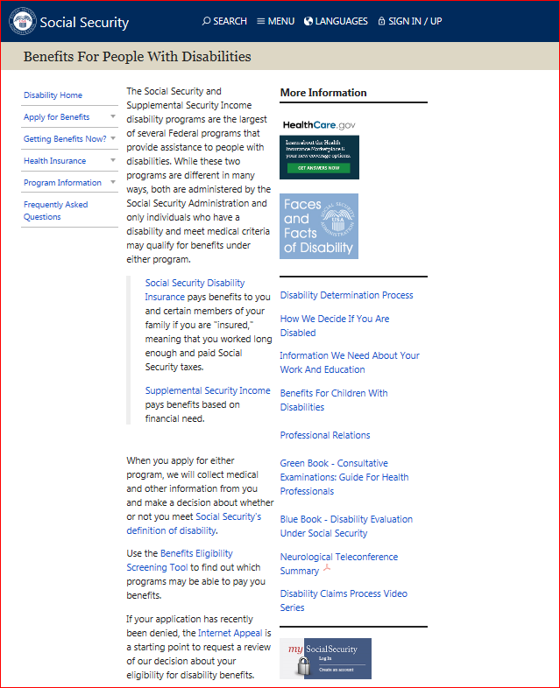

Slide 9
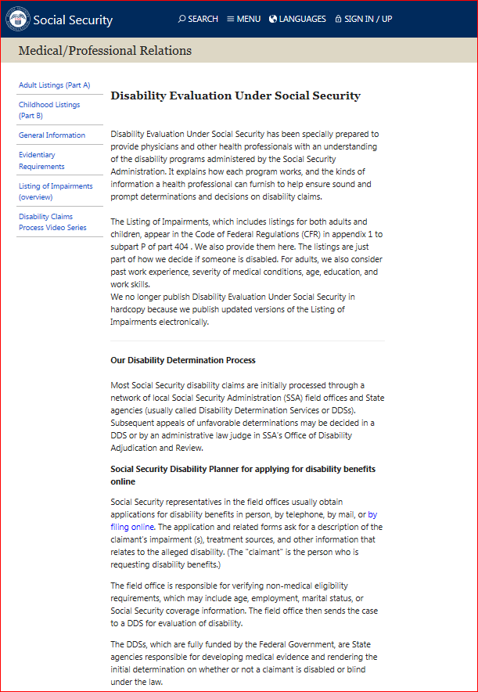

Slide 10
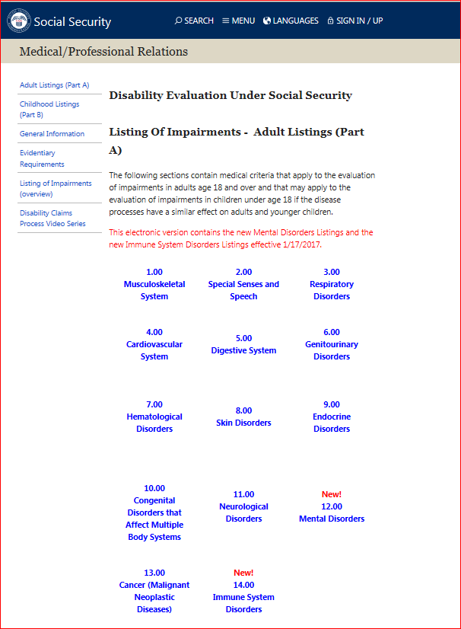

Slide 11
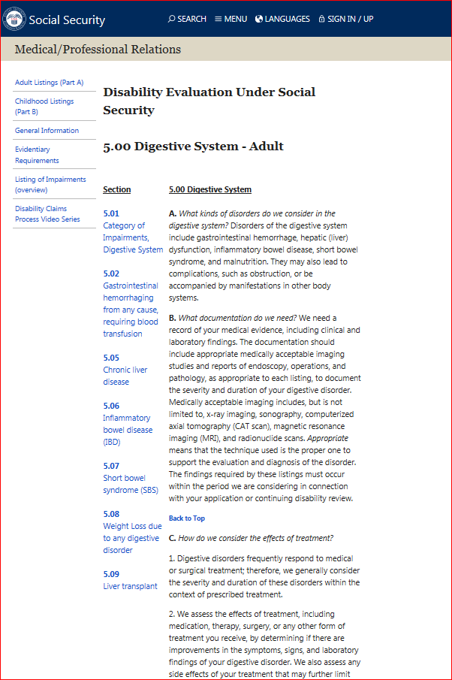

Slide 12
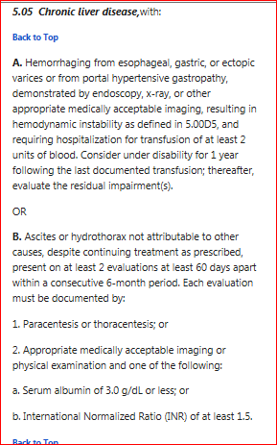

Slide 13
If you disagree with the Age 18 medical decision…
Reconsideration
Hearing
Must submit a written appeal within 60 days
Payment continuation is possible if appeal is filed within 10 days (through hearing level)

Slide 14
When We Review A Disability Case
When Improvement is Expected – Diary is set
When Improvement is Possible - 3 years
When improvement is not Expected - 7 years
When you become eligible for SSI
under Sec 1619
If we find that the claimant
Is no longer disabled -
BENEFITS STOP

Slide 15

Non-Medical eligibility SSA will ask for….
Information about your income, including work activity
Information about your resources
Information about your living arrangements

Slide 16

Payment Rates
Living alone or paying fair share
$841.00
Household of another
$560.67
Medicaid Facility
$30.00

Slide 17

What about Health Insurance?
SSI links people to Medicaid
SSDI links people to Medicare

Slide 18
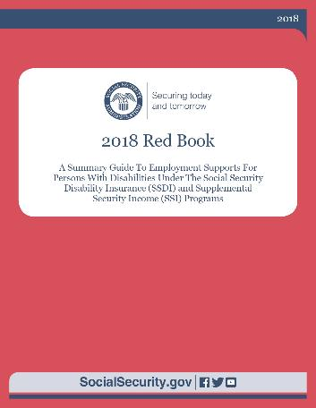
Work Incentives

Slide 19
Section 301 Payments
Those participating in an approved program of special education, vocational rehabilitation or similar services can continue to receive SSI
Program began before SSI eligibility ends
Continued participation will likely result in employment with earnings above SGA.
Examples: IEP age 18-21; VR agency; Support services using an individualized plan; Service plan with a school; SSA PASS

Slide 20

Ticket to Work
TTW Employment Service Providers
Free employment services to help you find a job or maintain success while working.
Includes career counseling, vocational rehab and job placement and training.
TTW program may improve earnings
potential and help to prepare for
long-term success
socialsecurity.gov/work
1-866-YOURTICKET (1-866-968-7842)

Slide 21

Work Incentives under SSI
Earned Income Exclusion
First $65
1/2 of the remainder
Student Earned Income Exclusion
Exclude $2,040 per month
Yearly maximum - $8,230
Plan for Achieving Self-Support (PASS)
Property necessary for self support
Impairment-Related Work Expenses

Slide 22
SSI Earned Income Example
Oscar receives SSI of $841.00 and he starts a job earning $500 a month.
$500 wages
-$20 unearned income exclusion
-$65 earned income exclusion
$415
\2 divide in half
$207.50 countable income

Slide 23
Oscar’s Monthly Income
SSI payment would have been $841.00
New SSI payment $841- CI $207.50=$633.50
Wages $500
SSI $633.50
Total monthly income $1133.50
Oscar’s monthly income has increased by $292.50

Slide 24

Student Earned Income Exclusion (SEIE)
Youth under age 22 and regularly attending school
College 8 hours/week
High School 12 hours/week
Training course to prepare for employment 12 hours/week
Transition employment preparation program while in Special Education
$1,930/month
$7,770/year

Slide 25

SEIE example
Jim works at a grocery store and earns $600 a month.
Earnings $600 x 12 months = $7,200 year
Yearly Student exclusion= - $7,670 year
Countable income = $0

Slide 26

Plan to Achieve Self-Support
Set aside income and resources to use for a work goal.
Examples of expenses
Educational expenses
Vocational training
Assistive technology
Expenses for starting a business
Form SSA-545
Specific work goal
Specific time frame

Slide 27

PASS Example
Ann wants to go to school to become a RN
Ann receives SSDI of $1200 a month
Ann needs $1180 a month for tuition, books and supplies. This amount is excluded for the approved Plan to Achieve Self-Support
Ann is eligible for SSI of $841.00 to use for living expenses and uses the PASS funds of $1180 for approved plan expenses

Slide 28

Impairment Related Work Expense (IRWE)
Deduct cost of certain impairment-related items and services from gross earnings
Item or services enables you to work
Needed because of impairment
Item or service is not reimbursed by
another source
Cost is reasonable

Slide 29
IRWE example
Deduct cost of Impairment Related Work Expenses from gross earnings when SGA determination is made
Lou earns $1000 a month
IRWE expenses (by month) Service animal $50
Prescription co-pays $40
Attendant care $250
Countable earnings $660 (before earned income exclusions)

Slide 30

Additional Work Incentives under SSI
Section 1619 Work Incentives
Special SSI Payments for People
Who Work
Continued Medicaid Eligibility
Reinstatement Without a New
Application

Slide 31
Work Incentives Planning and Assistance (WIPA)
WIPA provides information and benefits counseling to help you understand how work and earnings affects your benefits
Contact Ticket to Work to locate a WIPA project
1-866-833-2967
Choosework.ssa.gov/findhelp

Slide 32
Protection and Advocacy for Beneficiaries of Social Security (PABSS)
Protect legal rights of beneficiaries who want to work
Identify an remove barriers to employment
Information about obtaining VR services
Contact Ticket to Work to locate PABSS organization
1-866-968-7842
Choosework.ssa.gov/findhelp

Slide 33
Grants and Scholarships
Do not count as income or resources for up to nine months
Must be used for tuition, fees, and other necessary educational expenses.
Pell grants and student aid loans, BIA student assistances does not count as income for SSI

Slide 34
Achieving a Better Life Experience (ABLE) Account
Tax-advantaged savings account for an individual with a disability
ABLE account funds can be used for disability-related expenses
ABLE accounts (up to $100,000) do not account as an SSI resource
ABLE accounts are funded by the account owner, family, friends
Eligibility for an ABLE account
Eligible for SSI based on a disability or blindness that began before age 26; or
Entitled to SSDI or CDB based on a disability or blindness that began before age 26; or
Have a certification that disability or blindness occurred before age 26

Slide 35
Reporting Responsibilities Under SSI
What Things Must You Report To Social Security?
You must report any changes in your status because they may affect your eligibility for SSI and your benefit amount. If you work and get SSI, then you must report your earnings.
When Do You Need To Report?
Report any changes that may affect your SSI as soon as possible and no later than 10 days after the end of the month in which the change occurred.
How Do I Report Wages?
Social Security offers a toll-free automated wage reporting telephone system and a mobile wage reporting application. You can also report your wages through your personal my Social Security account.
Notes:
https://www.ssa.gov/ssi/text-report-ussi.htm

Slide 36
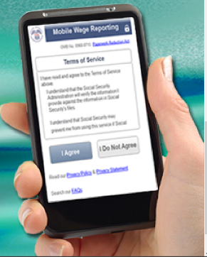
Wage Reporting
Mail pay stubs to your local office
SSI Telephone Wage Reporting
Toll-free (866)772-0953
Internet Wage Reporting via my Social Security
SSI Mobile Wage Reporting application (SSIMWR)
Download free application in Google Play or Apple App Stores.

Slide 37
my Social Security Services
If you receive benefits or have Medicare, you can:
Opt out of mailed notices for those available online;
Request a replacement Social Security card if you meet certain requirements;
Report your wages if you work and receive Disability Insurance (SSDI) and/or Supplemental Security Income (SSI) benefits;
Get a benefit verification letter as proof that you are getting benefits;
Check your benefit and payment information and your earnings record;
Change your address and phone number;
Start or change direct deposit of your benefit payment;
Submit your advance designation of representative payee request;
Request a replacement Medicare card; and
Get a replacement SSA-1099 or SSA-1042S for tax season.
ssa.gov/myaccount/what.html
Notes:
So what can you do with a my Social Security account? Your online my Social Security account provides a wealth of information to help you and your family plan for your financial future
URL updated 12/17/2020 (JP)

Slide 38
my Social Security Services
If you do not receive benefits, you can:
View retirement benefit estimates at different ages or dates when you want to start receiving benefits;
View possible spouse’s benefits;
Request a replacement Social Security card if you meet certain requirements;
Check the status of your application or appeal;
Get a benefit verification letter as proof that you are not getting benefits;
Get your Social Security Statement to review:
Estimates of your future retirement, disability, and survivor benefits;
Your earnings record, to verify the amounts that we posted are correct; and
The estimated Social Security and Medicare taxes you’ve paid.
ssa.gov/myaccount/what.html
Notes:
Slide updated 2/18/2021 (JP)

Slide 39
How to Open a my Social Security Account
Visit ssa.gov/myaccount
Select: “Sign In or Create an Account”
Provide some personal information to verify your identity (answer “out of wallet” questions)
Choose a username and password
Select how to receive a security code every time you access your account (text or email)
Notes:
To open a my Social Security account, you have to be at least 18, have a valid e-mail address, a Social Security number, and a U.S. mailing address.
To open your account, go to ssa.gov/myaccount and select “Sign In or Create an Account.”
One way to register for an account is to provide some personal Social Security information about yourself, then provide answers to some questions only you are likely to know the answers to. These are to verify your identity.
They are multiple-choice questions referred to as “out of wallet” questions - if someone was to steal your wallet, they could not use the information they stole to answer any questions.
Next, you choose a “username” and an 8-character “password” to access your online account.
If you do not answer the multiple-choice questions correctly, you will be suspended, but only for 24 hours. Then you can try again. You do not have to contact Social Security.
However, if there is a discrepancy in the personal information you enter and Social Security’s records, you’ll have to visit a Social Security office with your ID.
No matter what type of device you use, the my Social Security portal will automatically re-adjust to fit the appropriate screen size, providing you full, easy-to-use access to your personal account!
Updated 8/27/2020 (JP)

Slide 40

Q&A session
Notes:
Option for speaker:
You can use this slide OR switch to the visual “Rotating Brand Images” presentation found on the PARC as a scrolling visual while answering questions.

