Slide 1

Employment First 2.0: Developing a Foundation for Excelling Systems Change Efforts through Legislative Action
Community of Practice (CoP) series
January 11, 2022

Slide 2
Thank You for Joining us for Today’s
National Community of Practice Webinar
Our program will begin promptly at 3:00 p.m. EST. Until then, please sit back and enjoy the music!

Slide 3

Employment First 2.0: Developing a Foundation for Excelling Systems Change Efforts through Legislative Action
Community of Practice (CoP) series
January 11, 2022

Slide 4
Maximizing Your Webinar Participation:
Zoom Tips, 1/2
  Audio Settings: You can change your audio settings. You can also click the upward arrow (^) next to the microphone icon at the lower-left of the Zoom window to change your speaker.
  Captioning: Available in a separate browser window by clicking the link to the following page on Captioned Text.
  Questions: If you have a question for today’s presenters, please type it in the Q&A box at any time during the presentation. You do not have to wait for the Q&A discussion to begin. Open the Q&A window, type in your question, and then press “send.” You can also include questions in the chat box. You will receive a reply back via text in the Q&A window or the question will be answered live.

Slide 5
Maximizing Your Webinar Participation:
Zoom Tips, 2/2
During the Interactive Discussion
  Raise Hand: Raise your hand when the interactive discussion begins if you would like to provide feedback or make a comment regarding a specific question that has been asked of the participants.
  Unmute/Mute: Once the host acknowledges you, you can unmute by pressing the “Mute/Unmute” button at the task bar at the bottom of your screen, and then provide your comments. All participants will be able to hear you during this time. Be sure to mute yourself again after you have made your comments.
Leave meeting: Click Leave meeting to leave the webinar at any time. You can rejoin if the webinar is still in progress.

Slide 6

Agenda
Welcome
ABLE South Carolina
California State Council on Developmental Disabilities
Disability Rights California
DETAC Technical Assistance Updates
Questions, Comments, and Interactive Discussion

Slide 7
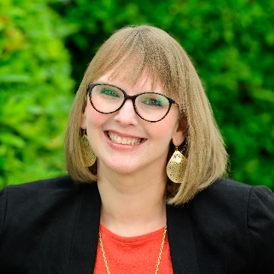
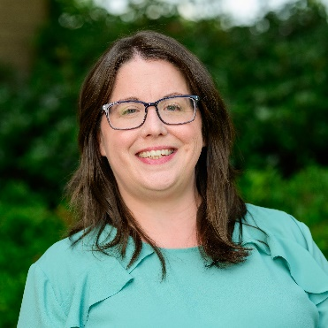
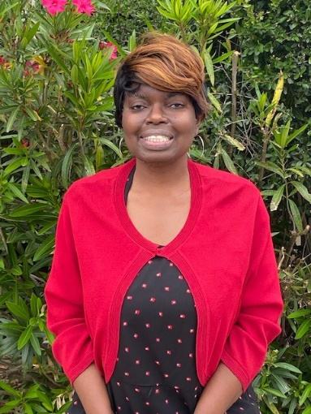
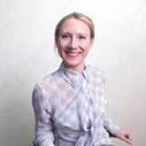
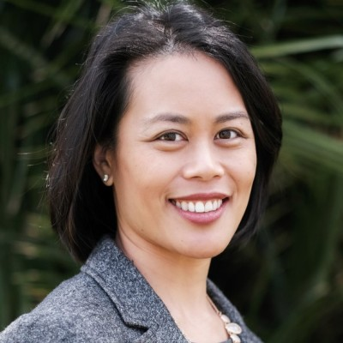
Speaker Introductions
Kimberly Tissot
Sandy Jordan
Angela Greene
Tania Morawiec
Vivian Haun

Slide 8

Employment First 2.0: Developing a Foundation for Excelling Systems Change Efforts for People with Disabilities through Legislative Action
January 11, 2022
DETAC Community of Practice Webinar

Slide 9
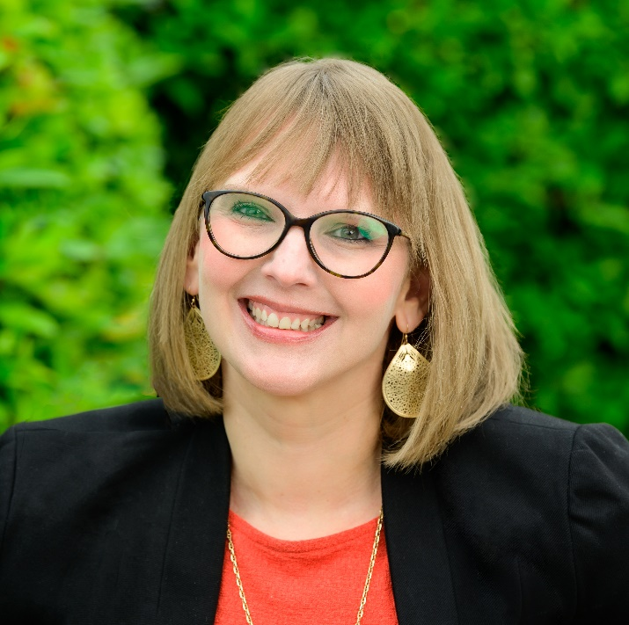

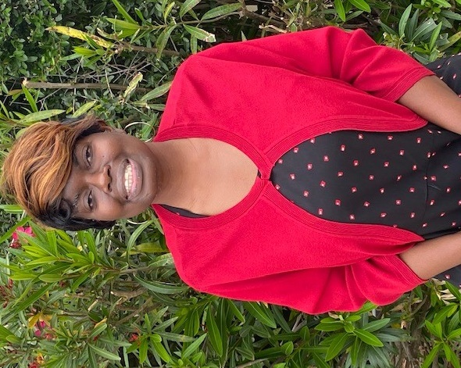
Meet your Speakers
Kimberly Tissot (she/her)
CEO/President
Able SC
Sandy Jordan (she/her)
Director of Employment Programs
Able SC
Angela Greene (she/her)
Self-Advocate

Slide 10

Able South Carolina
Center for Independent Living.
Covers 23 counties (Upstate/Midlands of SC) but majority of programs are statewide.
Over 80% of our staff are people with disabilities.
Core Services
  Information & Referral
  Independent Living
  Advocacy
  Peer Support
  Transition (Youth & Community)

Slide 11
Foundation with Legislators
Passed Right to Parent Act in 2017. Introduced the Employment First Initiative Act in 2017.
Held regular meetings with legislators to inform them of issues affecting the disability community.
Built relationships with key legislator “champions” for disability rights.
Started Advocacy Day for Access and Independence in 2014 (yearly event), typically held at SC State House, which helped with exposure of disability rights issues.
Grassroots efforts: utilizes Salsa Labs to allow consumers to contact legislators on important issues with ease.

Slide 12
Subminimum Wage legislation
One legislator champion came to us in 2020 wanting to phase out subminimum wage in SC after we raised the issues.
  Researched other states legislation related to subminimum wage.
  Drafted legislation which was introduced in February 2021.
  Scheduled meeting with Senate members to get support on subminimum wage and advocate for legislation.
  Provided testimony at every hearing; coordinated other speakers.
  Issued press releases to engage the media and the public.
  Developed legislative handout and FAQs to educate legislators and the community.
  Paired with local DD providers and self-advocates who have transitioned from subminimum wage to share their story through legislative testimony.
The legislation, once passed, includes a three-year phase out of subminimum wage in SC

Slide 13
Funding Structure for Legislative Work
•ACL grantees can NOT lobby with any federal funding. However, you can provide education on how a certain bill can impact the disability community. You just can't introduce a bill or take a position on a bill.
•You CAN lobby with unrestricted, non-federal funding.

Slide 14

Partners
Disability Rights SC (SC’s P&A)
SC Developmental Disabilities Council
USC’s Center for Disability Resources (SC’s UCEDD)
SC Vocational Rehabilitation/SC Commission for the Blind
Local DD providers
LIFE programs
SC Department of Education
Family Connection of SC (SC’s PTI)
SC’s Transition and Post-Secondary (TPSID) programs
Individuals, family members, and employers
Non-traditional entities (other social justice organizations)

Slide 15

How Did we Involve Partners?
Involved partners by having them sign onto a collective letter to legislators and having some of our partners provide testimony during legislative meetings.
Built relationships with DD providers “champions”
  Provided testimony at legislative hearings.
Currently applying for a DDC grant to help us feature success stories of providers who are transitioning out of sheltered workshops.

Slide 16
Impact and Outcomes
We found the sentiment for phasing out subminimum wage in SC was further along than we had predicted.
Media exposure has increased knowledge of subminimum wage in SC.
Our DD agency is now holding regular meetings with providers to discuss subminimum wage and potential for phase out.
We realized that subminimum wage data was incorrect, and providers are doing better than numbers indicate.
The fear of ending subminimum wage from families needed to be addressed.

Slide 17
Tips for CILs and other AoD Grantees 1/1
Get to know your legislators
  Meet with them frequently and let them know the barriers the disability community faces.
  Give them relevant information. Handouts and fact sheets can be helpful. Keep it simple!
Reassure partners that there will be a phaseout and the goal is not for individuals to be left without services.
Find DD service provider champions to be a peer model.
Keep your consumers informed via social media and eblasts so they can contact their legislators.

Slide 18
Tips for CILs and other AoD grantees 1/2
Collect and share success stories
  Individuals who have transitioned into competitive employment.
  DD providers who have or are in the process of phasing out subminimum wage.
Share progress with your media contacts.
Remove the fear within families and DD providers.

Slide 19
Angela Greene: My Sheltered Workshop Story
I was in a sheltered workshop for 21 years, from 1994-2015.
  I worked Monday-Friday making about $3/hour.
In 2015, I moved and the new agency I worked with believed in me and helped me gain employment in the community. They took a chance on me.
I always believed that community employment was possible, but I didn’t always have the support to achieve employment.
Being in the sheltered workshop did not allow me to use my skills, gifts, and to explore other opportunities.
I am an advocate for phasing out subminimum wage and have provided my personal testimony of being in a sheltered workshop to SC legislators.

Slide 20
Angela’s advice to others in a sheltered workshop
Follow your dreams no matter what others say, tune out the negative, and always try to embrace thoughts of inspiration instead of negativity.

Slide 21
Angela Greene: Today
  I have been working in the community for 7 years now. I work at the University of South Carolina as a dining room attendant. I have also worked for Able SC during the summer as an Administrative Assistant.
  I am currently working towards receiving my GED and have many career goals. I have an interest in social work, art, and public relations.
  I am active member of my church. I am a founding member and current secretary of IMPACT SC. I am a graduate of the Partners in Policymaking Training Program and have traveled to other states to participate in numerous Self-Advocates Becoming Empowered (SABE) Conferences.

Slide 22


California SB639 & CIE
Champions For
Change
1/11/22

Slide 23
Laying the Foundation
“Prime the pump”, partial 14(c) elimination in environments like state hospitals in previous bills
Change takes time-
  California becomes and Employment First State, AB 1041 legislation (10/9/13)
  CA Bill for 14-c phase out, SB 639 (9/10/21)
Think strategically about your authors/sponsors. Senator Durazo is a very well known-labor/civil rights advocate with deep ties across CA
  https://youtu.be/JUxjZ8ykjKQ 7:37-8:59

Slide 24
Strategy
Identify lessons learned from other states find political similarities, Maryland policy and others (statutes and legislative effort)
Consider cost, politics and policy as you vet amendments through the committee process
Plan a proactive narrative that includes self-advocates’ lived experiences
Prepare earlier, anticipate counter narrative
Include business perspective
Engage opposition and proponents in a meaningful, collaborative way throughout the process
Leverage current events and timely reports: workshops closed during pandemic, GAO report recommending ending 14(c)

Slide 25
Strategy Continued
Evolving Politics-Do not assume party line votes. Moderates and those with high numbers of 14(c) in their areas
  Despite National Republican Party supporting the end 14-c, no CA Republican voted for this Bill
  Some Democrats fought to kill the Bill
Focus on Specific Areas
  High number of certificate holders
  Population density/legislative representation (LA alone has about 40 members)

Slide 26
Broaden Approach to Reach Across Silos
Self-advocate focus
Cross-departmental work
  How many committees?!
Optimize intersectionality
  civil rights, labor
  self-determination
  HCBS/DDS-75 millions dollars spent on modernization for community integration
Strategy for political expediency
  Required budget neutrality for bill survival
Leverage federal resources and initiatives
Social media and other media outlets
Leverage and enhance existing statewide initiatives
  CIE Blueprint for change
  CA as Employment First state
Tap into state’s values (what do you pride yourself on?)
  CA: fair work/fair pay; civil rights

Slide 27
Mobilization/Activating the Base
METHODS
Plain language fact sheets, web-based information sessions
Sending letters to Senate Labor and Human Services Committees
Call in line sponsored by CA APSE
Preparing witnesses to testify
Organize call-ins on hearing days
GOALS
Clarify what the Bill does
Build enthusiasm
Develop Champions
https://www.senate.ca.gov/media/senate-floor-session-20210909/video 5:58.17-6:04.51
Get the word out

Slide 28
Implementation Planning
SB 639 primarily addresses implementation through the establishment of a stakeholder workgroup process
This is the vehicle to accomplish many of the statutory requirements.
  National SME as facilitators
  Careful selection of diverse, core group members
  Robust opportunities for other stakeholders to submit/share recommendations

Slide 29
Implementation
Phase out by 2025
Measurable, Outcomes based-what are these measures and quality incentives?
Upskill the field-strengths based, systematic instruction, job development best practice
Work as a part of meaningful day and person-centered planning

Slide 30

Questions, Comments and Interactive Discussion

Slide 31

January CoP Office Hours
January 14, 2022:
12:00-1:30 PM EST
Do you have a question for a CoP presenter, Kimberly, Sandy, Tania, or Vivian?
Need time with an expert to talk through strategies?
Free opportunity to get technical assistance!
Join with Google Meet
Meeting ID
meet.google.com/ebj-ofdk-qcr
Phone Numbers
(‪US‬)‪+1 612-315-0217‬
PIN: ‪750 796 998#‬

Slide 32

Upcoming Webinar
February 8, 2022:
3:00-4:30 PM EST
Advancing Competitive Integrated Employment through Managed Long-Term Services & Supports & Value-Based Payment Methodologies by Creating and Sustaining Partnerships with Medicaid, Managed Care Organizations and Other Stakeholders

Slide 33
New Results in Systems Excellence (RISE) eLearning Community!
Topic: Assistive Technology and Employment
For: All Grantees: CILs, DD Councils, UCEDDs, P&As, TBI Grantees, and PNS
Facilitators: Jennifer White/Able Opportunities & AT3 Center
Space is Limited – Apply Here: https://forms.gle/boxaF626cmy2vhU38
Dates:
  Start: February 24, 2022
  End: May 5, 2022

Slide 34

Learning Management System is Complete!
Subject Matter Experts developing content
Content will be uploaded into the platform
Grantees receive email blasts with information to register for classes

Slide 35

Does Your Team Need Help with Moving the Needle on CIE?
Need Free Technical Assistance?
Submit your request to the
on-demand TA request page
Reach out to us by emailing AoDemploymentTA@gmail.com

Slide 36

DETAC Contact Information
Email:
AoDemploymentTA@gmail.com
Website:
https://aoddisabilityemploymenttacenter.com
DETAC Publications:
https://aoddisabilityemploymenttacenter.com/detac-publications/

