Slide 1



N4 Connect – Mobility as a Service
Connecting 13 Transportation Agencies Across Northern Nevada
Enhancing Connectivity of Services
Able to Support Coordination of Transportation Services, Enhance Data and Reporting, and Increase Access for Individuals & Social Service Agencies

Slide 2
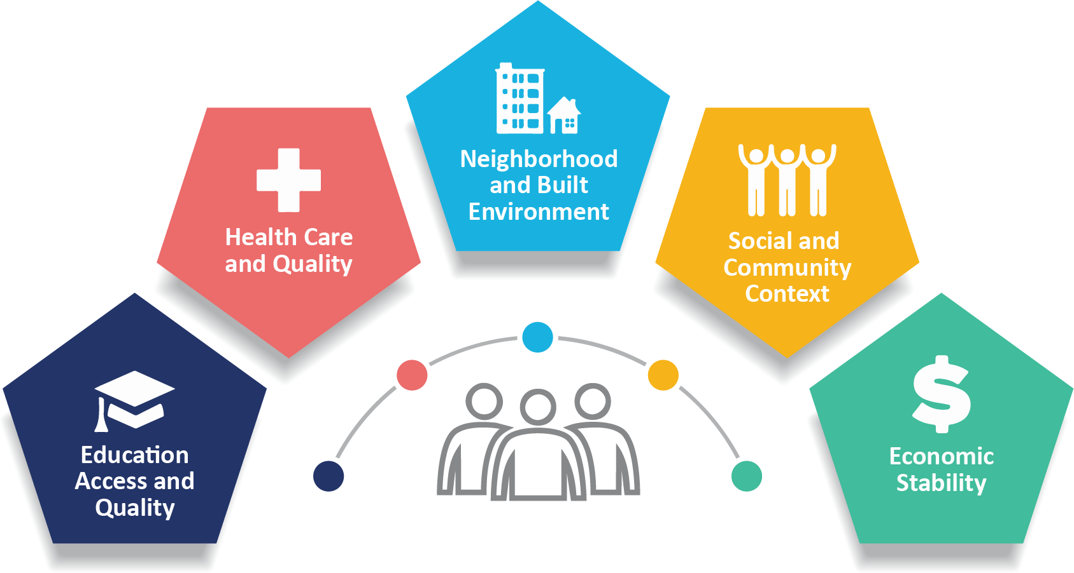
Social Benefit Goals = Primary Goal
Increase Access to all Social Determinates of Health

Slide 3

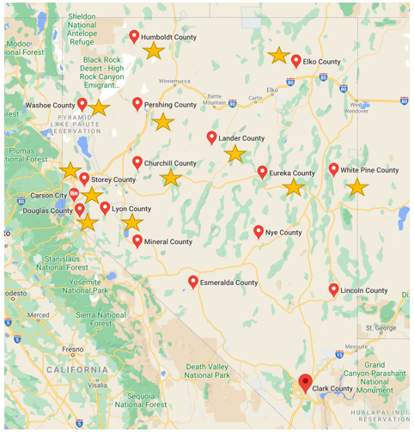

Pilot Locations

Slide 4




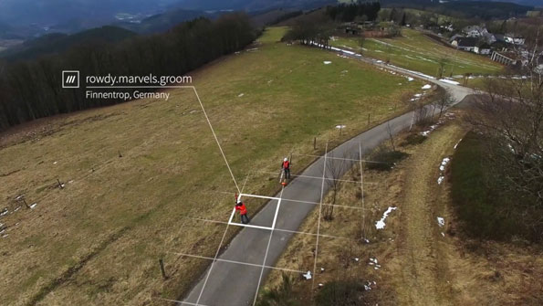
Global Technology Focus
Fit the Technology to the Transit Agency
Human Centered Design Approach to Technology Roll-Out & Deployment
Accessibility Testing in App with Screen Readers
Integration of what3words for Addresses

Slide 5

Layers of Mobility Integration Available
Trip Planning Across the Region and Modes
  Fixed Route & Paratransit
  Deviated Fixed Route
  Demand Response
  Volunteer
Requesting a Trip & Receiving Reminders About Scheduled Trips
Paying for a Trip
Seeing the Vehicle Arrival in Real Time

