Slide 1
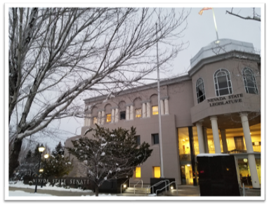
Department of Employment Training and Rehabilitation (DETR)
Rehabilitation Division
Agency 901

Slide 2
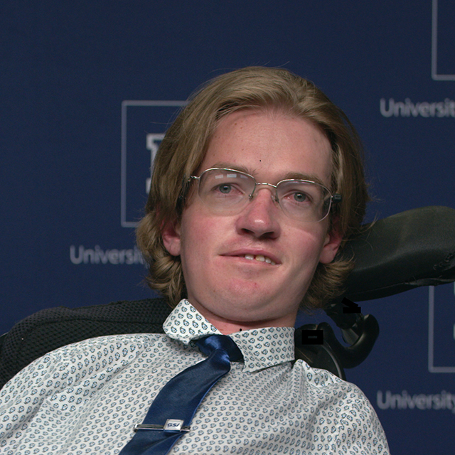
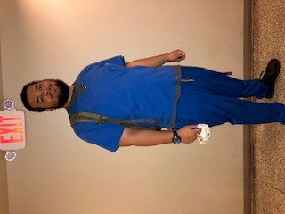
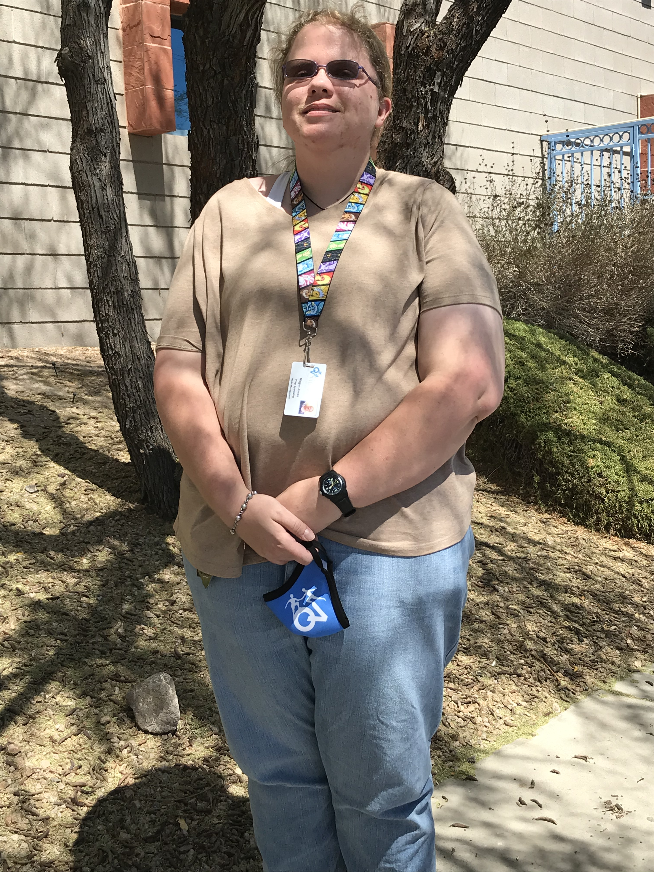
Actively engaging with Nevada businesses to understand their employment needs while creating innovative programs that develop the strengths, priorities, and talents of individuals with disabilities, ensuring that Nevada works for everyone. Provide fair and timely medical determinations to Nevadans seeking disability benefits through SSA programs in pursuit of healthcare and access to resources at critical times in their lives.
Rehabilitation Division/Agency 901
Mission Statements
2

Slide 3
Rehabilitation Division/Agency 901
BUREAU OF SERVICES TO PERSONS WHO ARE BLIND OR VISUALLY IMPAIRED (BSBVI)
B/A 3254
B/A 3265
BUREAU OF VOCATIONAL REHABILITATION (BVR)
Assists in removing barriers to competitive, integrated employment for Nevadans with disabilities through services such as training, education, work readiness training, assistive technology, job development and job coaching.
Provides employment seeking services such as: low vision aids, mobility training, assistive technology, and vocational training, and provides vital assistance in obtaining competitive, integrated employment.
B/A 3268
REHABILITATION ADMINISTRATION
B/A 3269
Provides timely, accurate medical determinations to Nevadans claiming benefits under the Social Security Administration’s disability programs
(Social Security Disability Insurance and Supplemental Security Income).
Is a unique private/public arrangement which delivers opportunities and support to Nevadans who are blind to establish entrepreneurial enterprises in public buildings.
B/A 3253
BLIND BUSINESS ENTERPRISE OF NEVADA (BEN) PROGRAM
BUREAU OF DISABILITY ADJUDICATION (BDA)
3

Slide 4
Rehabilitation Division/Agency 901
Budget Item | BA 3268 REHAB ADMIN. | BA 3269 BDA | BA 3265 BVR | BA 3254 BSBVI | BA 3253 BEN
Base Positions | 12.0 FTE | 121.0 FTE | 117.0 FTE | 18.0 FTE | 7.0 FTE
New Positions | -0- FTE | -0- FTE | -0- FTE | -0- FTE | -0- FTE
Intermittent Positions | -0- FTE | 27.0 FTE | -0- FTE | -0- FTE | -0- FTE
Total Positions | 12 FTE | 148 FTE | 117 FTE | 18 FTE | 7 FTE
General Fund (GF) | $ 0 | $ 0 | $ 4,606,732 | $ 977,638 | $ 0
GF Percentage of 901 Budget | 0 % | 0 % | 4.81 % | 1.02 % | 0 %
Federal Funding (DOE and SSA) | $ 0 | $40,286,609 | $32,940,520 | $ 4,909,777 | $ 0
Other Funds (C/A, interagency transfers, balance forward & BEN) | $ 2,898,910 | $ 0 | $39,873 | $ 21,932 | $ 9,021,026
Total Operating Budgets - Agencies | $ 2,898,910 | $ 40,286,609 | $ 37,587,125 | $ 5,909,347 | $ 9,021,026
TOTAL OPERATING BUDGET – DIVISION 302 FTE |  |  | $ 95,703,017
First bullet point here
Second bullet point here
Third bullet point here
Class | Group A | Group B
Class 1 | 58 | 25
Class 2 | 76 | 88
Class 3 | 84 | 90
4

Slide 5







Rehabilitation Division/Agency 901/Voc. Rehab.
BUREAU OF VOCATIONAL REHABILITATION (BVR)
AND
BUREAU OF SERVICES TO PERSONS WHO ARE BLIND OR VISUALLY IMPAIRED (BSBVI)
BVR
B/A 3265
BSBVI
B/A 3254
5

Slide 6


Vocational Rehabilitation (B/A 3265 & 3254)
135
FTE
Statewide
POVERTY RATE*
# OF WORKING AGE NEVADANS WITH DISABILITIES
With disability
320,336
Without disability
$13.69
EMPLOYMENT RATE*
PEOPLE WITH DISABILITIES
Make up the nation’s largest minority group, as well as the only group that any one of us can become a member of at any time.
Per Hour
AVERAGE WAGE (FFY20)
With disability
6
Without disability
* Cornell University 2018

Slide 7
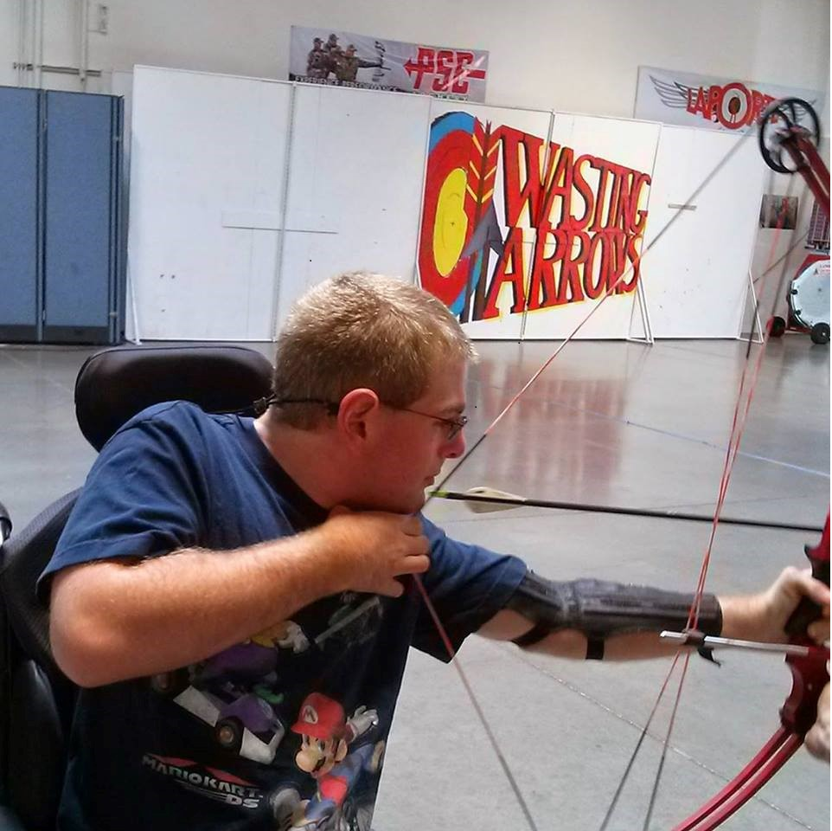
Vocational Rehabilitation (B/A 3265 & 3254)
Meet Brenden
He has several significant physical barriers to employment.
He loves games and sports and has a great sense of humor.
Customized employment services resulted in job exploration at a Reno indoor archery range called, “Wasting Arrows.”
After seeing Brenden in action and getting to know him, the business owners reached out to Brenden with a job offer as a “Range Master.”
As an accommodation, Brenden uses a hand operated buzzer rather than a whistle to instruct archers to collect their bows, shoot their arrows, and retrieve their arrows.
His supervisor reports that Brenden is the best Range Master they have.
7

Slide 8

Vocational Rehabilitation (B/A 3265 & 3254)
Return on Investment:
For every $1 invested in VR there is a $2.96 savings for taxpayers over the life of a client.
For every General Fund dollar invested, the State saves $16.73 over the life of a client.
Dollars are returned to the state in terms of increased taxes and decreased benefits from public programs.
Study was conducted by internal agency analysts using methodologies developed by sources below. The calculations are in line with the findings of the other national studies on the subject.
SOURCES: — University of Utah – Center for Public Policy & Administration
— Portland State University – Northwest Center for Economic Research
— The George Washington University - Institute on Rehabilitation Issues
8

Slide 9
Vocational Rehabilitation (B/A 3265 & 3254) Budget Pressures
INTERNAL PRESSURES
Pre-Employment Transition Services (Pre-ETS) Funding Reserve requirements
Loss of Third-Party Cooperative Arrangements (TPCAs)
Reduction in Blind Business Enterprise Activity/Expenditures (Soft Match to draw Federal Funds into VR)
Appropriations Bill - Section 10
EXTERNAL PRESSURES
Reduction of General Fund Match, which reduces associated Federal Funds
Increase in Unemployment
Potential Significant Increase in New Client Applications due to the pandemic
Potential Increase in Number of Returning Clients or Clients reactivating their cases
9

Slide 10
Vocational Rehabilitation (B/A 3265 & 3254) COVID-19 Budget Reduction
B/A 3265 & 3254 | SFY 2022 | SFY 2023
General Fund (G01) | $2,841,504 | $2,742,866
General Fund (GF) Cap | $3,279,460 | $3,279,460
Reduction from GF Cap | $437,956 | $536,594
Percentage of Reduction | 13.4% | 16.4%
Percent Reduced from Cap
10

Slide 11
Vocational Rehabilitation (B/A 3265 & 3254) COVID-19 Budget Reduction
 | REVENUES - Budget Reduction | SFY 2022 | SFY 2023 |  | TOTAL
Cat 00 | Appropriation Control (General Fund) | $437,956 | $536,594 |  | $974,550
Cat 00 | Federal Section 110 Grant | $1,618,175 | $1,982,627 |  | $3,600,802
 | Total Div. 901 – Revenue Budget Reduction | $2,056,131 | $2,519,221 |  | $4,575,352
 | EXPENDITURE - Budget Reduction | SFY 2022 | SFY 2023 |  | TOTAL
Cat 01 | Personnel (E680) | $113,564 | $114,280 |  | $227,844
Cat 09 | Client Services (E681) | $1,941,704 | $2,404,079 |  | $4,345,783
Cat 26 | Information Systems (E680) | $863 | $862 |  | $1,725
 | Total Div. 901 – Expenditure Budget Reduction | $2,056,131 | $2,519,221 |  | $4,575,352
11

Slide 12
Vocational Rehabilitation (B/A 3265 & 3254) Client Services Budget Level
12

Slide 13

Vocational Rehabilitation (B/A 3265 & 3254) Potential Nevadans Impacted
SFY 2021 SFY 2022 SFY 2023
Average Cost per case
$3,342
General caseload FFY2020
263
581
719
Potential Number of Clients Impacted by Reduced Funding
$879,151
$1,941,704
$2,404,080
Cat 09 – Client Services Budget Reduction Amount
13
General Fund Portion of Cat.09 Budget Reduction
$187,259
$413,583
$512,069

Slide 14
Vocational Rehabilitation (B/A 3265 & 3254) Increasing Costs for Service
+610%
+141%
4 Year College Degree
Assessments
+219%
+185%
+210%
14
Rehabilitation Technology
Transportation
Occupational & Vocational Training

Slide 15

Vocational Rehabilitation (B/A 3265 & 3254)
WIOA – New Mandate
Vocational Rehabilitation must spend at least 15% of its full Federal Section 110 Grant Award for the provision of Pre-Employment Transition Services (Pre-ETS) only to students with disabilities.
15
Notes:
Pre-Employment Transition Services (§361.48(a)) (Pre-ETS) are a group of new services required under the Workforce Innovation and Opportunity Act (WIOA). Nevada VR, in collaboration with education, MUST provide or arrange for the provision of Pre-ETS to all students with disabilities in the state (around 18,000) in need of such services, in accordance with §361.65.
Fiscal Guidance Summary:
Reserve and expend at least 15 percent of NV VR’s federal Section 110 grant award. (2019-027 Single audit finding )
The reserved funds must be used solely for the provision of pre-employment transition services.
This is not another source of funding or a separate grant, but an added requirement of the existing Section 110 grant funds.
May only spend the remaining 85% of federal Section 110 grant funds on general VR clients.

Slide 16
Vocational Rehabilitation (B/A 3265 & 3254)
Pre-ETS cutting into General Client Services
16

Slide 17
Pre-ETS Expenditures Capturing over 50% of Client Services Budget SFY 2022 & 2023
Vocational Rehabilitation (B/A 3265 & 3254)
Pre-ETS cutting into General Client Services
17

Slide 18
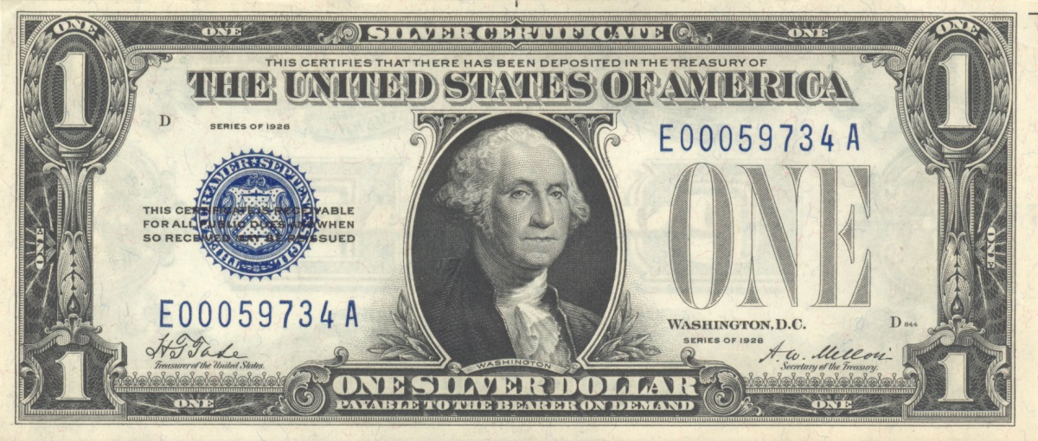
Vocational Rehabilitation (B/A 3265 & 3254)
21.3% Non-Federal Match
78.7% Federal VR Section 110 Grant
18

Slide 19
Vocational Rehabilitation (B/A 3265 & 3254)
21.3% Non-Federal Match
78.7% Federal VR Section 110 Grant
19

Slide 20
Vocational Rehabilitation (B/A 3265 & 3254)
Before and After TPCA budget reductions
20
*TPCA – Third Party Cooperative Arrangement
Notes:
Pre-Employment Transition Services (§361.48(a)) (Pre-ETS) are a group of new services required under the Workforce Innovation and Opportunity Act (WIOA). Nevada VR, in collaboration with education, MUST provide or arrange for the provision of Pre-ETS to all students with disabilities in the state (around 18,000) in need of such services, in accordance with §361.65.
Fiscal Guidance Summary:
Reserve and expend at least 15 percent of NV VR’s federal Section 110 grant award. (2019-027 Single audit finding )
The reserved funds must be used solely for the provision of pre-employment transition services.
This is not another source of funding or a separate grant, but an added requirement of the existing Section 110 grant funds.
May only spend the remaining 85% of federal Section 110 grant funds on general VR clients.

Slide 21

Blind Business Enterprise of Nevada (B/A 3253) Reduction in Business Activity
POST-COVID-19 RECOVERY PROJECTION
NORMAL YEAR
COVID-19 IMPACT
2019
2020
2021
ANNUAL GROSS REVENUE
ANNUAL GROSS REVENUE
ANNUAL GROSS REVENUE
$9,317,097
$6,353,649
$7,308,518
21
-31.8% vs 2019
-21.6% vs 2019

Slide 22
Vocational Rehabilitation (B/A 3265 & 3254)
Appropriations Bill – Section 10 Restrictions
Reversion of General fund not expended
Loss of associated federal funds that would have been drawn
Minimizes ability to carry forward federal funds and take advantage of a 2-year grant allowance
Logistics of spending funds within a 12-month period DUE TO state processes
Will always result in loss of state AND federal grant funds
22

Slide 23
Vocational Rehabilitation (B/A 3265 & 3254)
Federal Grant Funds Awarded vs. Funds Expended

Slide 24
Without sufficient resources, Nevada VR will be forced into “Order of Selection” – Waiting Lists
ORDER OF SELECTION
A State vocational rehabilitation (VR) agency is required to implement an order of selection when it anticipates that it will not have sufficient fiscal and/or personnel resources to fully serve all eligible individuals. (Section 101(a)(5)(A) of the Rehabilitation Act of 1973 (Act) and 34 CFR 361.36(a)(1))
PRIORITY CATEGORIES
WAITING LISTS
Under an order of selection, individuals with the most significant disabilities are selected first for the provision of vocational rehabilitation services, while those with less significant disabilities remain on waiting lists. (Section 101(a)(5)(C) of the Act and 34 CFR 361.36(a)(3)(iv)(A)).
An order of selection consists of priority categories to which eligible individuals are assigned based on the significance of their disability. (34 CFR 361.36(d)(1))
24
Notes:
ORDER OF SELECTION (OSS) - A State vocational rehabilitation (VR) agency is required to implement an order of selection when it anticipates that it will not have sufficient fiscal and/or personnel resources to fully serve all eligible individuals. (Section 101(a)(5)(A) of the Rehabilitation Act of 1973 (Act) and 34 CFR 361.36(a)(1))
OOS PLAN - Nevada State Rehabilitation Council (NSRC) and our federal oversight agency, the Rehabilitation Services Administration (RSA) would need to approve the OOS plan.
PRIORITY CATEGORIES - An order of selection consists of priority categories to which eligible individuals are assigned based on the significance of their disability. (34 CFR 361.36(d)(1))
WAITING LISTS - Under an order of selection, individuals with the most significant disabilities are selected first for the provision of vocational rehabilitation services, while those with less significant disabilities remain on waiting lists. (Section 101(a)(5)(C) of the Act and 34 CFR 361.36(a)(3)(iv)(A)).

Slide 25
Vocational Rehabilitation (B/A 3265 & 3254)
Meet Joey
He has several barriers to employment due to Autism and Specific Learning Disability.
He wanted to help people; to make them smile.
Received Pre-Employment Transition Services, including counseling, work readiness training and self-advocacy instruction.
Participated in Project Search, a partnership with VR, Clark County School District and Sunrise Hospital.
Project Search provided Joey with extensive skills training including independent living and job skills, career exploration, and job coaching.
Joey additionally began volunteering at Sunrise Hospital, who hired him full time in their Transport Department to transport patients to and from services and discharge.
Joey has full time meaningful work where he can deliver smiles to those in need.
25

Slide 26
Bureau of Vocational Rehabilitation (B/A 3265)
E805
1 FTE
Reclassify Administrative Assistant 1 to Rehabilitation Technician 3 | SFY 2022 | SFY 2023
 | $10,596 | $11,243
Total
$21,839
Supports the goal of competitive, integrated employment for Nevadans with disabilities
Supervision of Rehab. Tech. 2s was moved from Rehab. Counselor 3s to Rehab. Supervisors
Allowed Rehab. Counselor 3s to better utilize their education & expertise with clients
E805 creates a statewide Rehab. Tech. 3 to supervise and onboard Rehab. Tech. 2s,
Removes Rehab. Tech. 2s from the chain of command of Rehab. Supervisors
Ensures consistent and best practices within the Rehab. Tech. series
Creates opportunities to serve more Nevadans with disabilities by Rehab. Counselor 3s
26

Slide 27

Rehabilitation Division/Agency 901
BUREAU OF DISABILITY ADJUDICATION
BDA
B/A 3269
27

Slide 28
Bureau of Disability Adjudication (B/A 3269)
As of September 2020, the number of Nevada beneficiaries receiving disability benefits was:
Supplemental Security Income (SSI) 46,191
Social Security Disability Insurance (SSDI) 72,310
Total Nevada Disabled Beneficiaries (SSI/SSDI) 118,501
As of Sept. 2020, the average annual amount paid to Nevada disabled beneficiaries:
Supplemental Security Income (SSI) $ 338,352,000
Social Security Disability Insurance (SSDI) $1,038,960,000
Total Dollars (SSI/SSDI) $1,377,312,000
28

Slide 29

Bureau of Disability Adjudication (B/A 3269)
121
FTE
Statewide
# OF CASES PROCESSED FOR NEVADANS
DECISION ACCURACY
24,726
92.5%
+27 Intermittent Staff
+15 Contracted Medical Staff
122.1
FEDERAL FUNDS
DAYS
MEAN PROCESSING TIME
29
100%

Slide 30
Bureau of Disability Adjudication (B/A 3269)
E250
Replace outdated, unsupported phone system with cloud-based 8x8 | SFY 2022 | SFY 2023
 | $242,523 | $127,555
Total
$370,078
Funded 100% by Federal SSA funds. No General Fund.
Aligns with other DETR agencies using 8x8. Allows for DETR support and bulk rate pricing.
Cloud-based phone service
Desktop and Mobile applications
Instant messages via virtual office (voice or visual voice mail)
Office phone number forwarded to cell phone. Outgoing calls show office phone number.
30

Slide 31
Bureau of Disability Adjudication (B/A 3269)
E806
1 FTE
Reclassify Administrative Assistant 1 to Rehabilitation Technician 3 | SFY 2022 | SFY 2023
 | $17,260 | $18,172
Total
$35,432
Supports of the goal of providing accurate and timely decisions to thousands of Nevadans each year on their claims for Social Security disability benefits
Creates a statewide Rehab. Tech. 3 to supervise and onboard Rehab. Tech. 2s
Ensures consistent and best practices within the Rehab. Tech. series
Ensures Disability Adjudicators are supported in their work by Rehab. Tech. 2s with the highest degree of technical and professional knowledge and skills
31

Slide 32
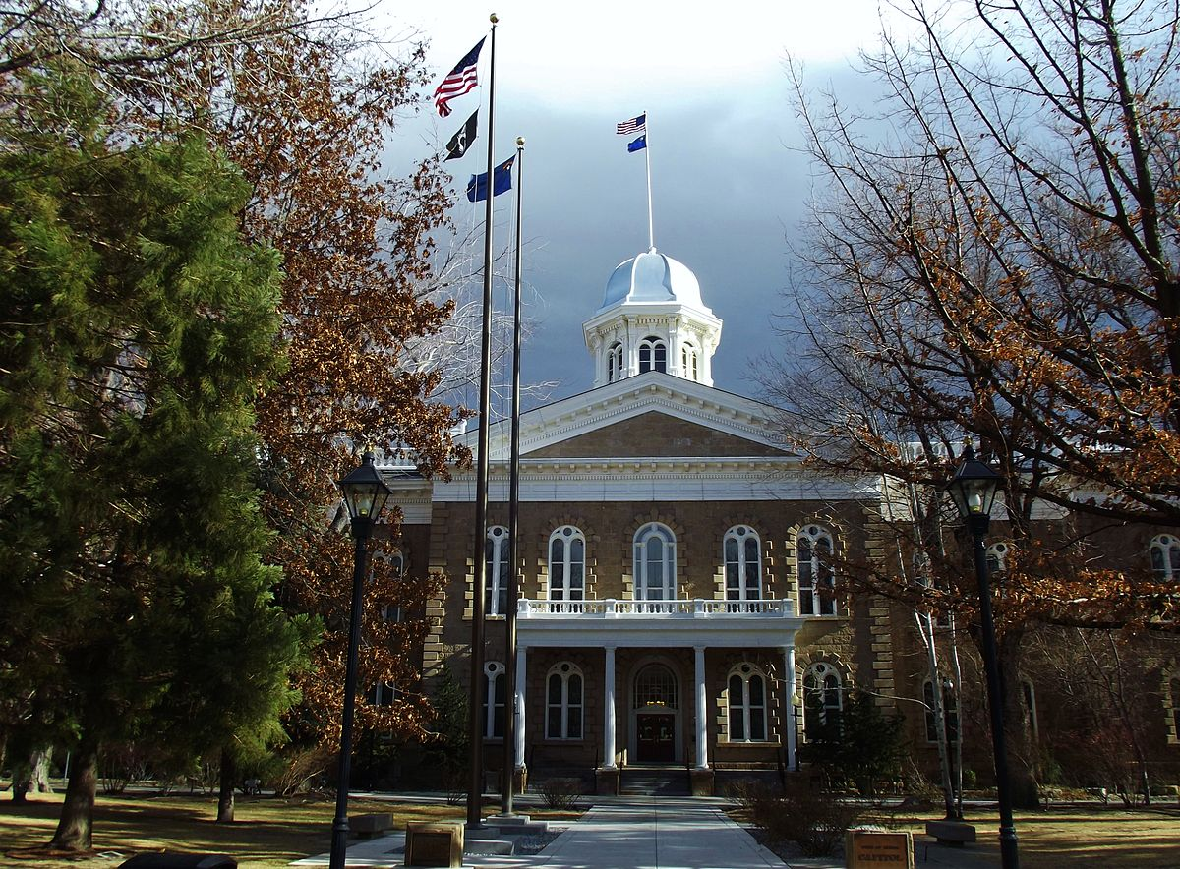

Balanced scorecard slide 10
Department of Employment, Training and Rehabilitation
THANK YOU
REHABILITATION DIVISION

