Slide 1



N4 Connect – Mobility as a Service
Connecting 12 Transportation Agencies Across Northern Nevada
6 Agencies in Year 1
6 Agencies in Year 2
Enhancing Connectivity of Services
Able to Support Coordination of Transportation Services, Enhance Data and Reporting, and Increase Access for Individuals & Social Service Agencies

Slide 2
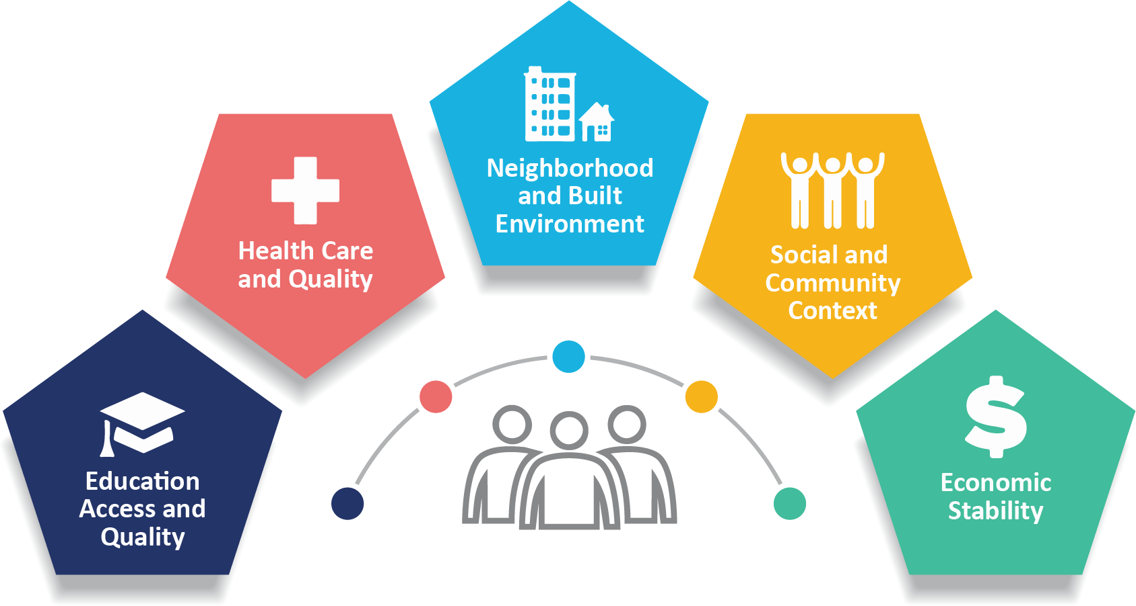
Social Benefit Goals = Primary Goal
Increase Access to all Social Determinates of Health

Slide 3

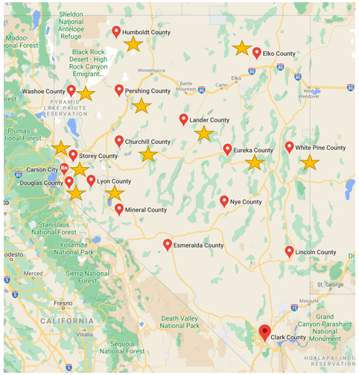

Pilot Locations

Slide 4




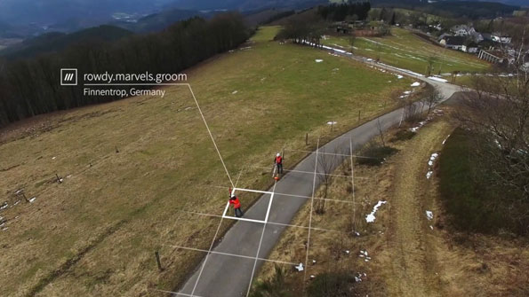
Global Technology Focus
Fit the Technology to the Transit Agency
Human Centered Design Approach to Technology Roll-Out & Deployment
Accessibility Testing in App with Screen Readers
Integration of what3words for Addresses

Slide 5

Layers of Mobility Integration Available
Trip Planning Across the Region and Modes
Fixed Route & Paratransit
Deviated Fixed Route
Demand Response
Volunteer
Requesting a Trip & Receiving Reminders About Scheduled Trips
Paying for a Trip
Seeing the Vehicle Arrival in Real Time

